Slide 1

The Holy Trinity: Blending Statistics, Machine Learning and Discrete Choice with Applications to Strategic Bicycle Planning
Timothy Brathwaite
UC Berkeley
Civil and Environmental Engineering

Slide 2
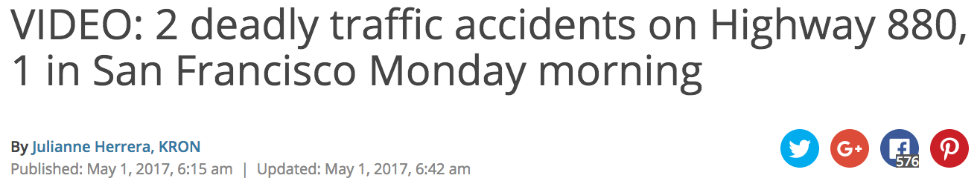
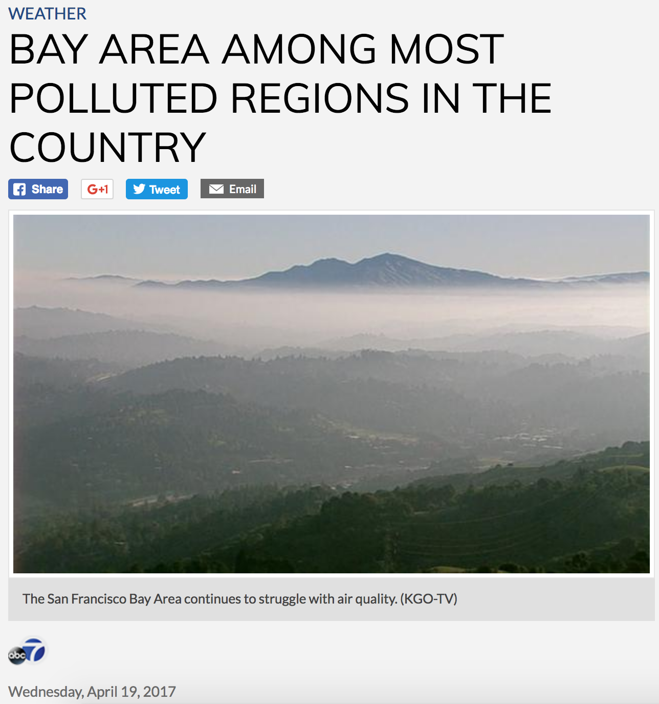
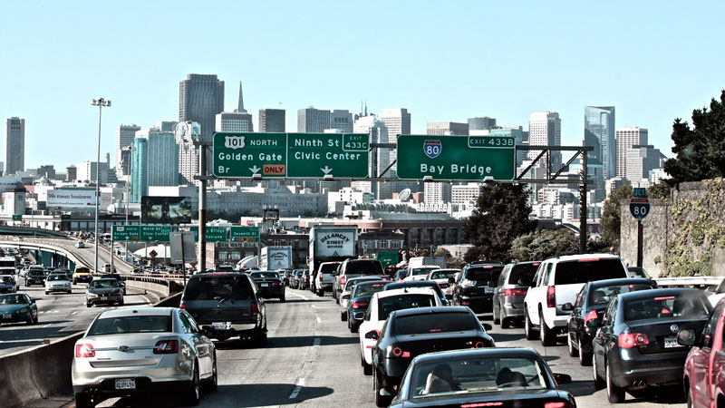
More Cars, More Problems

Slide 3

One Governmental Response:
Promote increased bicycle usage.

Slide 4
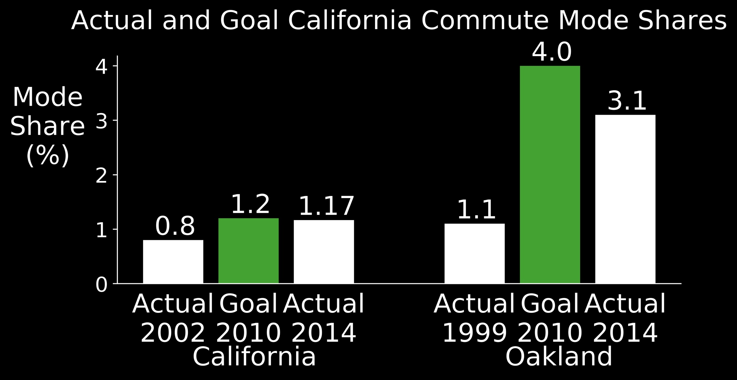
Outcomes have been poor:
Bicycle mode share goals are routinely missed.

Slide 5

Limited funding necessitates strategic investments

Slide 6
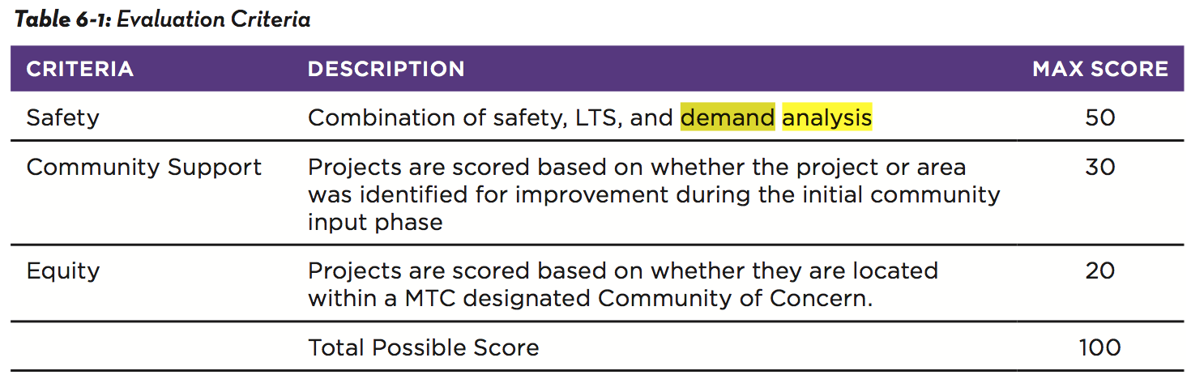
Limited funding necessitates strategic investments

Slide 7

How best to evaluate effects on bicycle demand?
Gold Standard: Travel Demand Model

Slide 8


Slide 9
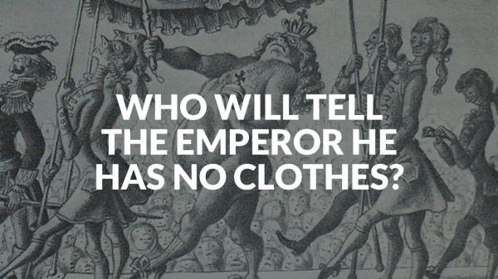

Slide 10
What are (some of) the problems?
Omission of relevant variables
Use of questionable behavioral assumptions
Ignoring statistical implications of the small number of cyclists.

Slide 11
My Contributions
“Zone of Likely Travel” + Decision Tree
Omission of relevant variables
Tree-Based Gaussian Process Choice Model
Questionable behavioral assumptions
Asymmetric Choice Models
Statistical implications of the small # of cyclists.
Notes:
Make note that the issues being addressed are motivated by bikes but more broadly applicable.

Slide 12
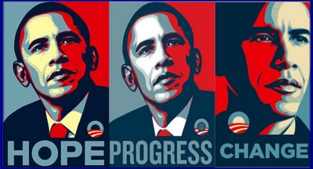
SÍ, se puede
Increasing the relevance of travel demand models for bicycle planning simultaneously increases their accuracy.

Slide 13
Outline
What’s a model?
How to incorporate bike relevant variables?
How to model “irrational” decision making?
How to model the “minority” mode?
Recap: So what?
What next?

Slide 14

Anatomy of a Model
Inputs
Outputs
Socio-demographics
Level of Service (e.g. Travel Time / Cost)
Probability of traveling by each mode

Slide 15
What’s missing?
Inputs
Outputs
Socio-demographics
Level of Service (e.g. Travel Time / Cost)
Bike Infrastructure? (e.g. lanes, paths, signs)
Traffic volumes?
Traffic speeds?
Topography?
Probability of traveling by each mode

Slide 16
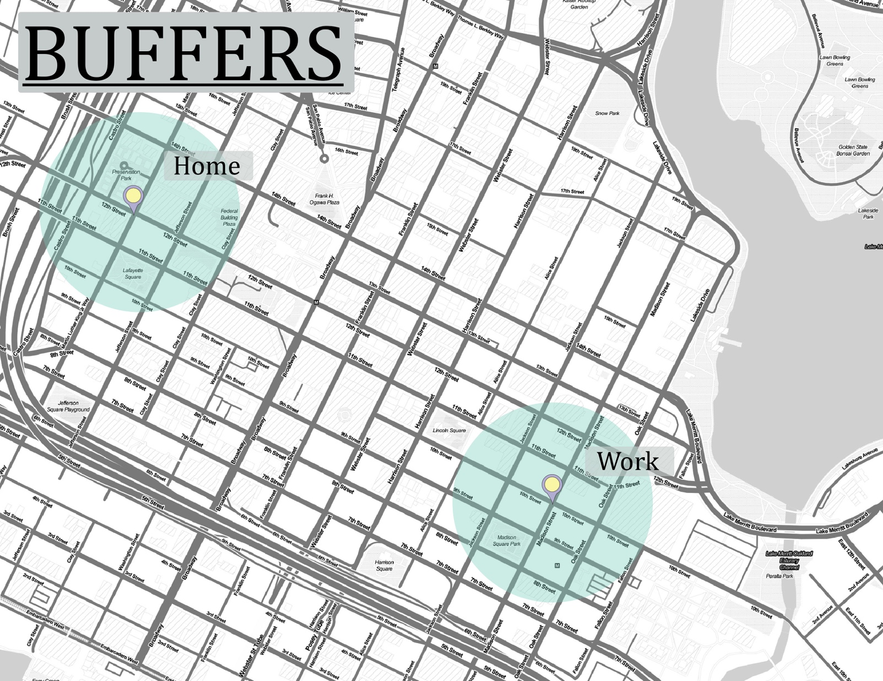
How have roadway level variables been previously incorporated?
Notes:
Make point that the typical procedure is to go from disaggregate raw data on each variable to an aggregated value for each variable.

Slide 17
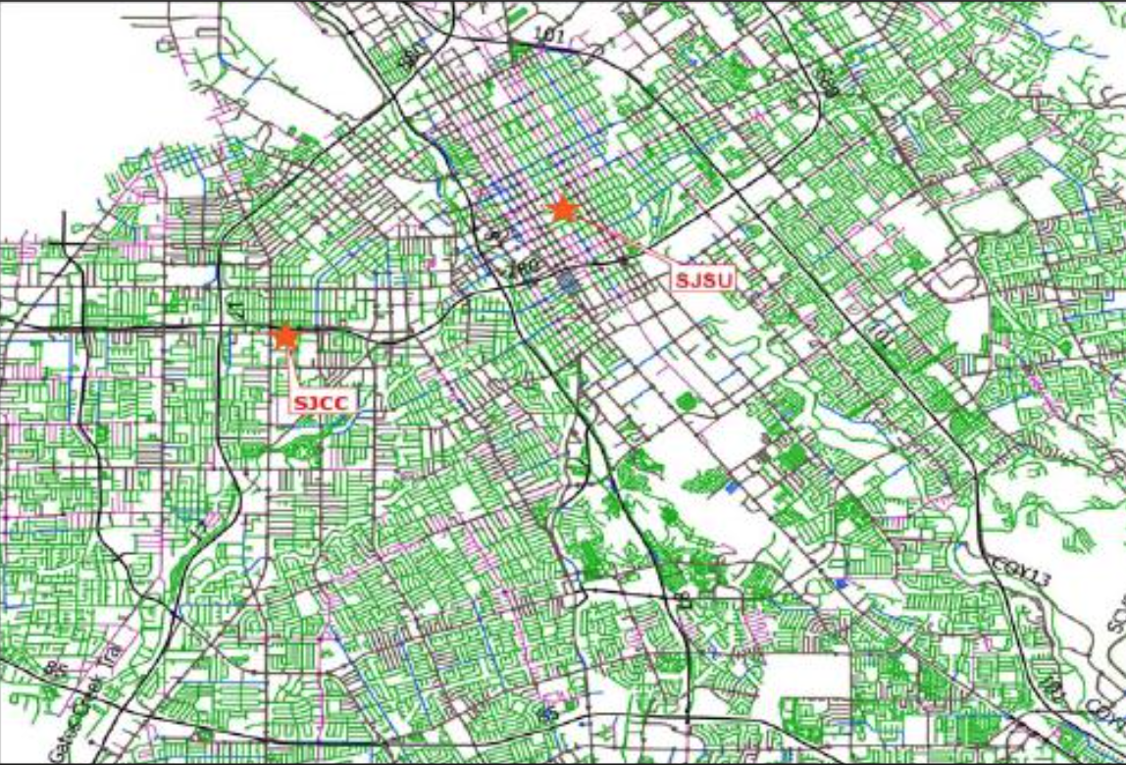
How have roadway level variables been previously incorporated?
Bicycle Environment Factors:
Score roadways
Aggregate scores
Mekuria et al. (2012), “Low-Stress Bicycling and Network Connectivity ”
Notes:
Make point that typical procedure is to go from disaggregate raw data on each variable to combined score for each street to a single aggregate score (across variables) for some fixed area.

Slide 18
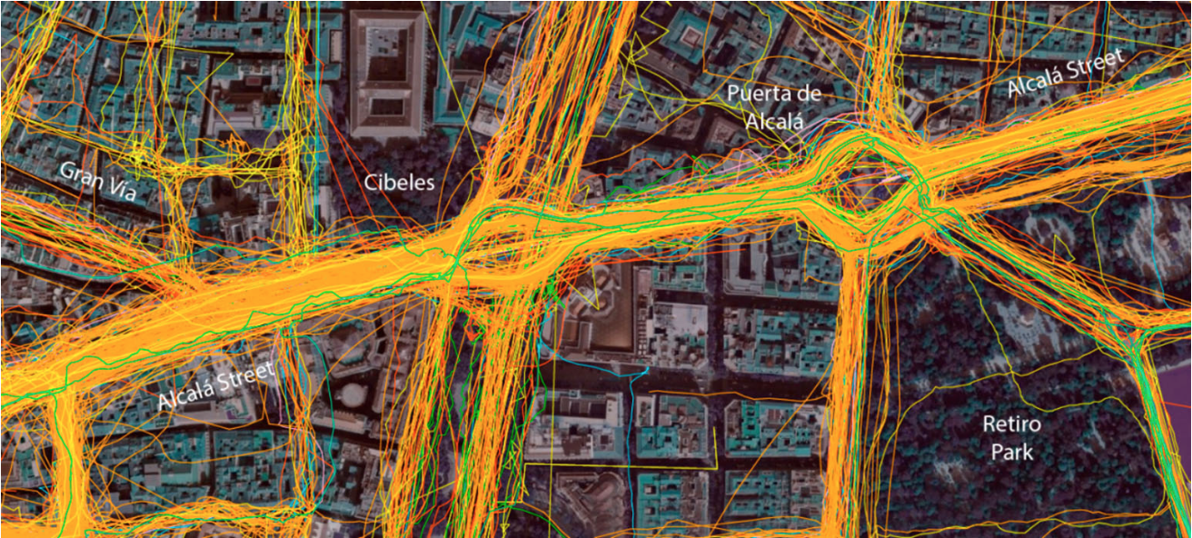
How have roadway level variables been previously incorporated?
Route Choice Models:
Score routes
Aggregate scores
Romanillos and Austwick (2016), “Madrid Cycle Track: Visualizing the Cyclable City” Hood et al. (2011), “A GPS-based bicycle route choice model for San Francisco”
Notes:
Make point that typical procedure is to go from disaggregate raw data on each variable to combined score for each street to a single aggregate score (across variables) for some fixed area.

Slide 19
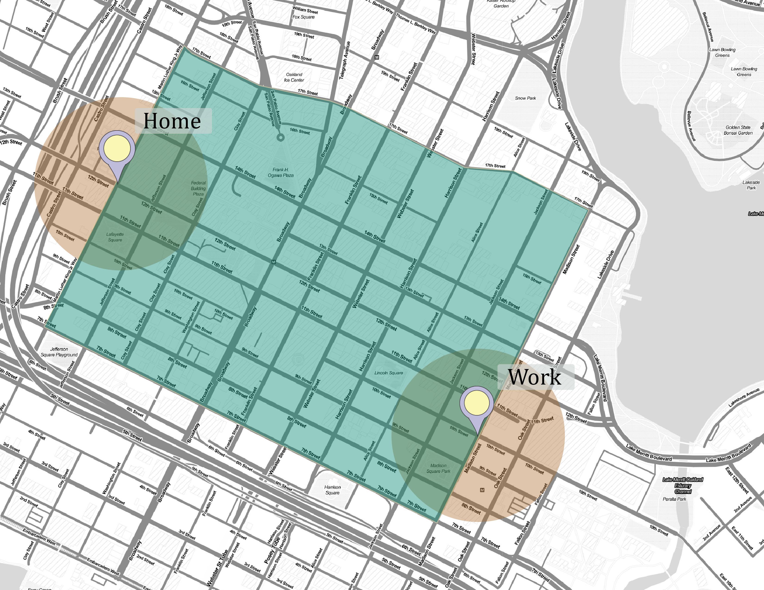
Problems with past approaches?
Buffers include too many irrelevant streets and exclude too many relevant streets.

Slide 20

Problems with past approaches?
Bicycle environment factors are either completely subjective or “un-interpretable.”
“Factor Analysis”
Ewing and Cervero (2001), Travel and the Built Environment: A Synthesis

Slide 21



Problems with past approaches?
Route Choice Models implicitly assume that current cyclists and non-cyclists have equal sensitivities.
≠
≠

Slide 22
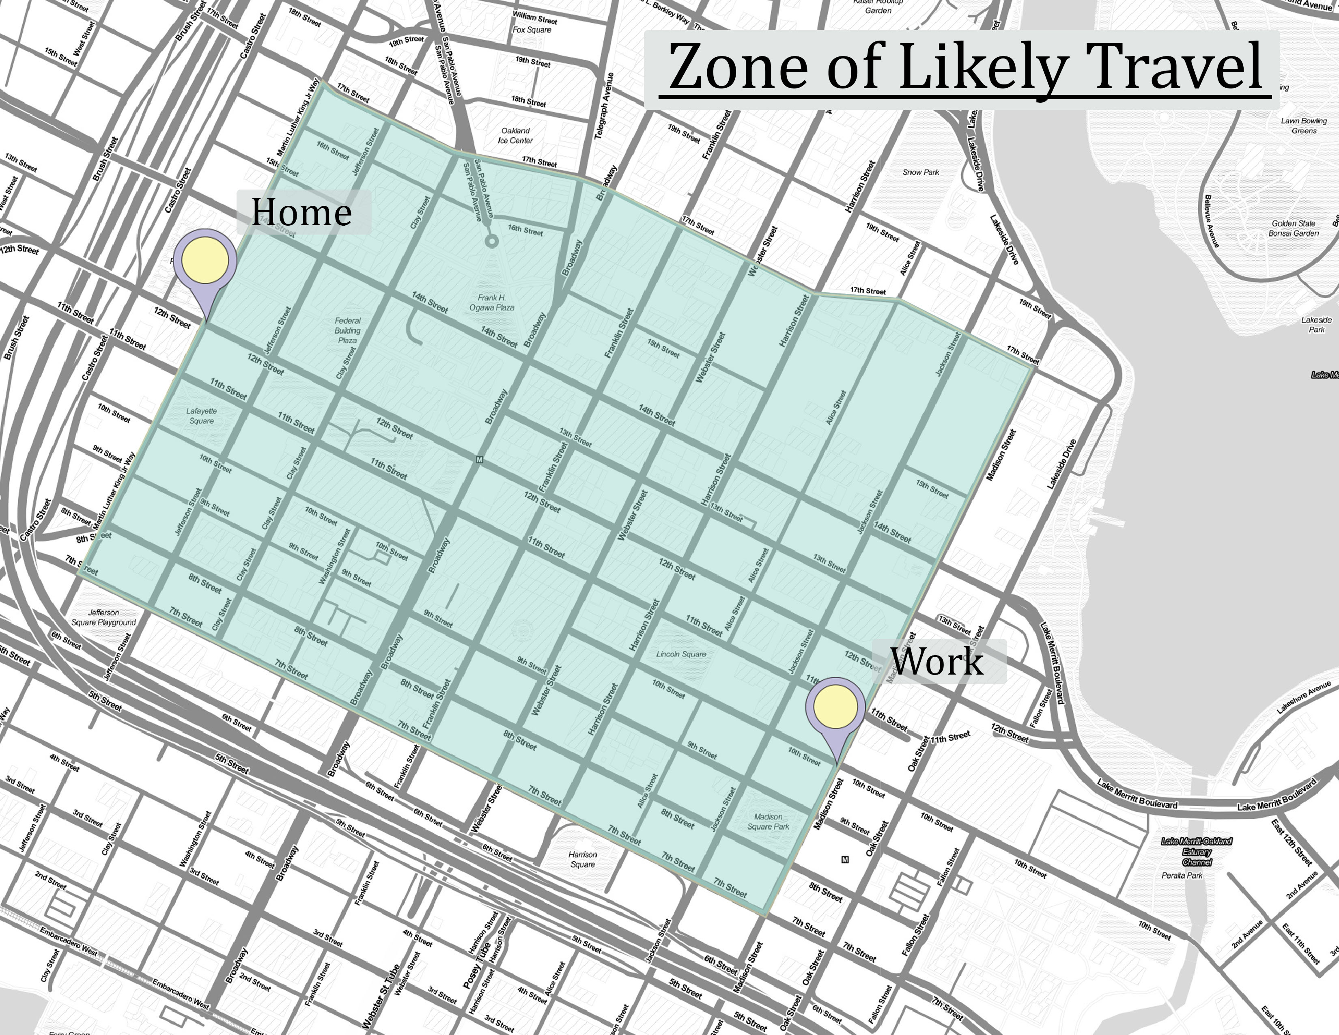
How else might we incorporate roadway-level variables?

Slide 23
How else might we incorporate roadway-level variables?
Decision tree for “situation description”
Min Distance > 4mi ←True, False→
# Bike / Total: 6 / 130
Average Slope > 0.1191
# Bike / Total: 9 / 112
Percentage Bike Lanes > 11%
# Bike / Total: 42 / 169
# Bike / Total: 30 /207

Slide 24
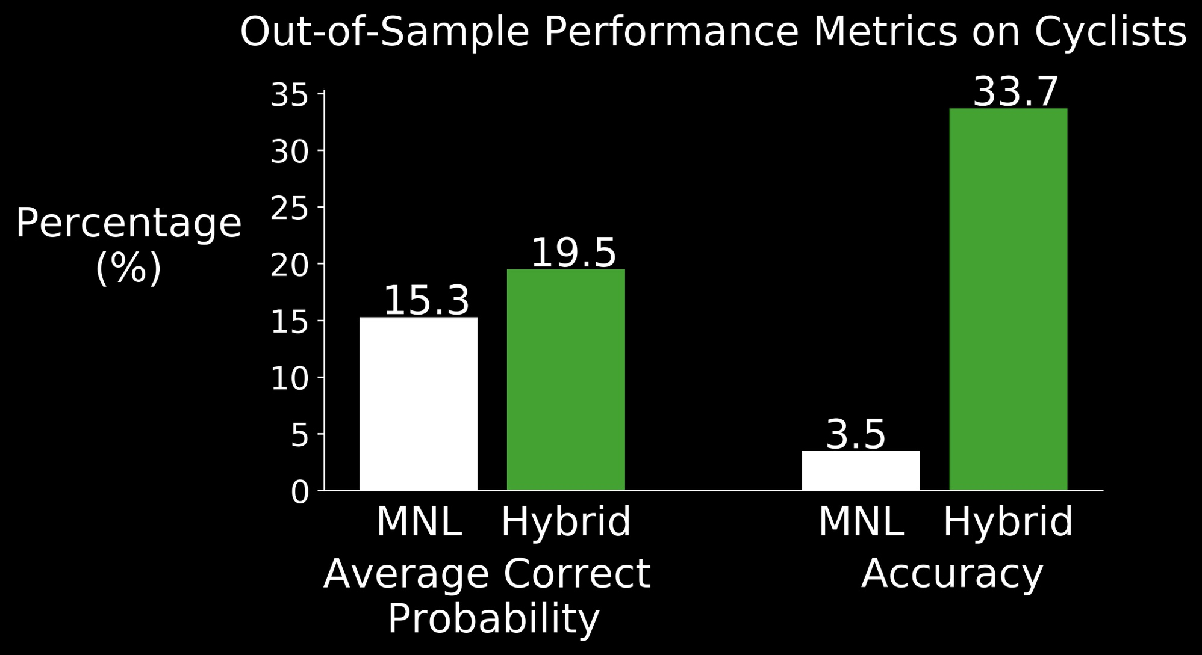
Zone of Likely Travel + Decision Tree = Increased Model Accuracy

Slide 25
Summary of Contributions (Part 1)
Demonstrated feasibility and benefit of incorporating relevant roadway variables
Increased sensitivity to roadways between origins and destinations
Systematically and interpretably combined roadway variables

Slide 26
What goes into the secret sauce?

Slide 27

Behavioral Assumptions
“Homo Economicus”

Slide 28

Perfectly Rational Humans are a Myth

Slide 29
If-Then Decision Making
Raining == True ←True, False→
Don’t Bike
Travel Time ≤ 30 min
Likely to Bike
Topography == Flat
Unlikely to Bike
Don’t Bike

Slide 30
“Pride cometh before a fall…”
Human behavior is complex, so we must account for our uncertainty

Slide 31
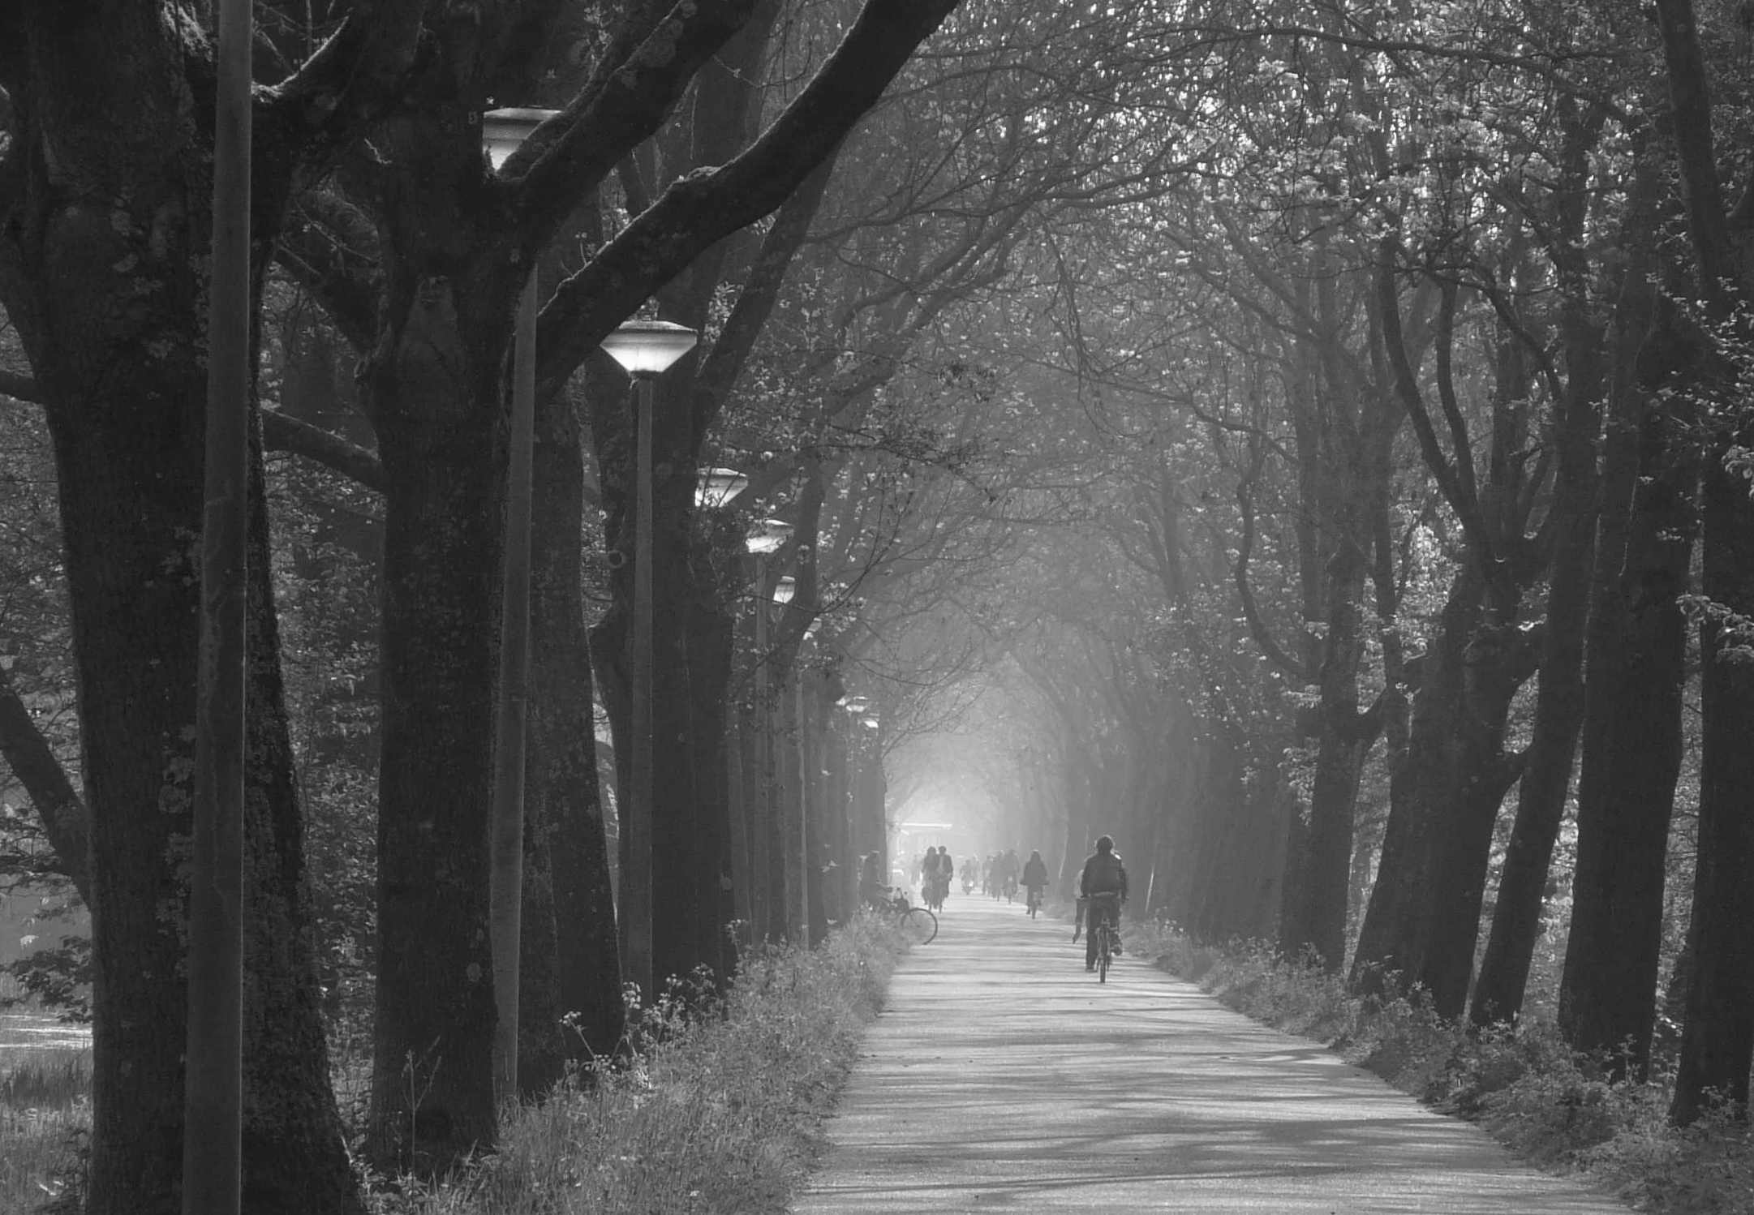
Putting it all together: Tree-Based Gaussian Process Model
Many trees to describe the potential sets of if-then rules

Slide 32
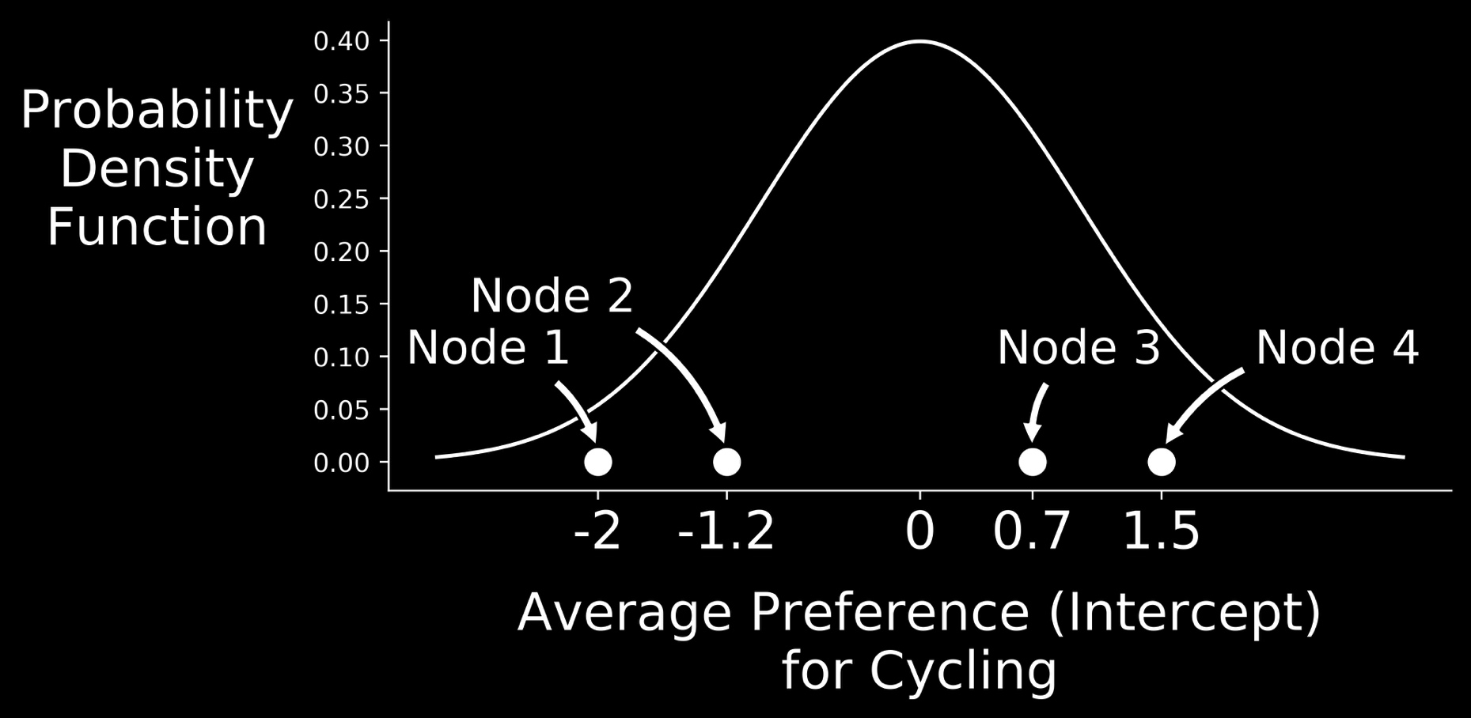
Putting it all together: Tree-Based Gaussian Process Model
Given a tree, the effect of each if-then rule is unique, but from a common distribution.

Slide 33
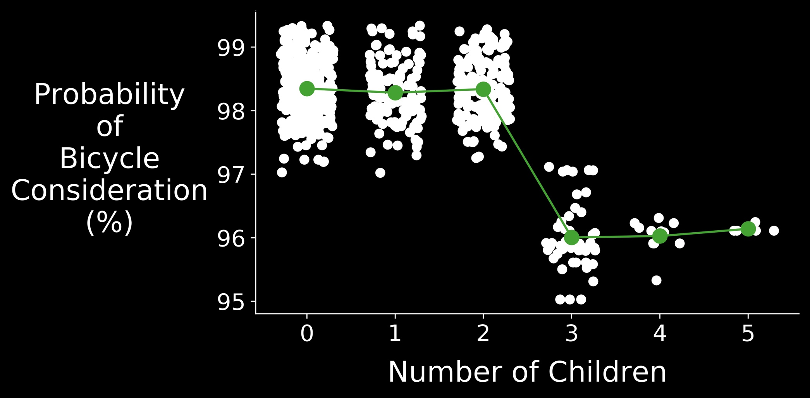
What are the (preliminary) results?

Slide 34
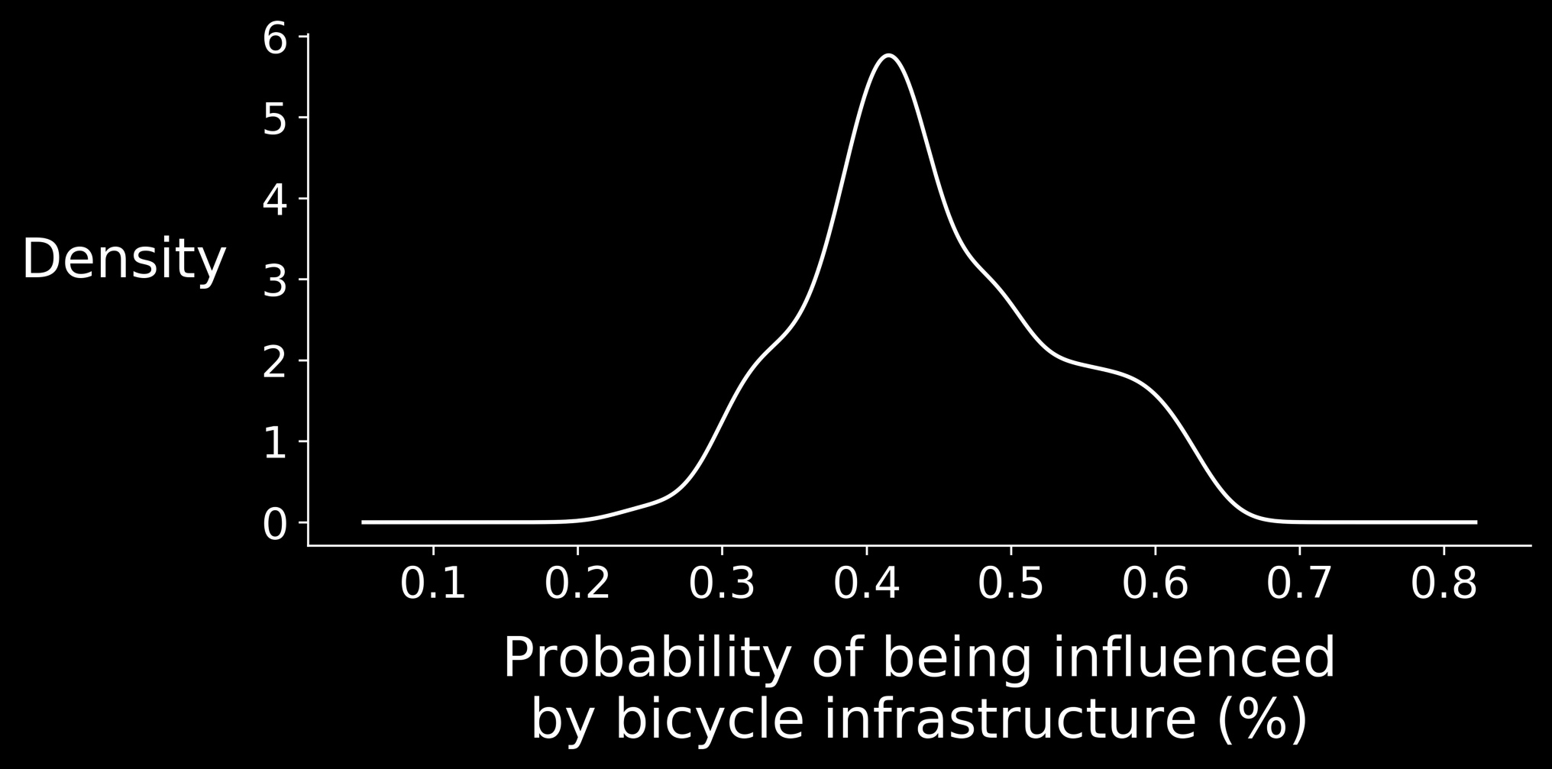
What are the (preliminary) results?

Slide 35
Summary of Contributions (Part 2):
Flexibly account for “irrationality”
Paints richer picture of bicycle consideration and environmental effects
Clarifies behavioral implications of decision trees
Econometrically links decision trees and choice models
Notes:
\

Slide 36
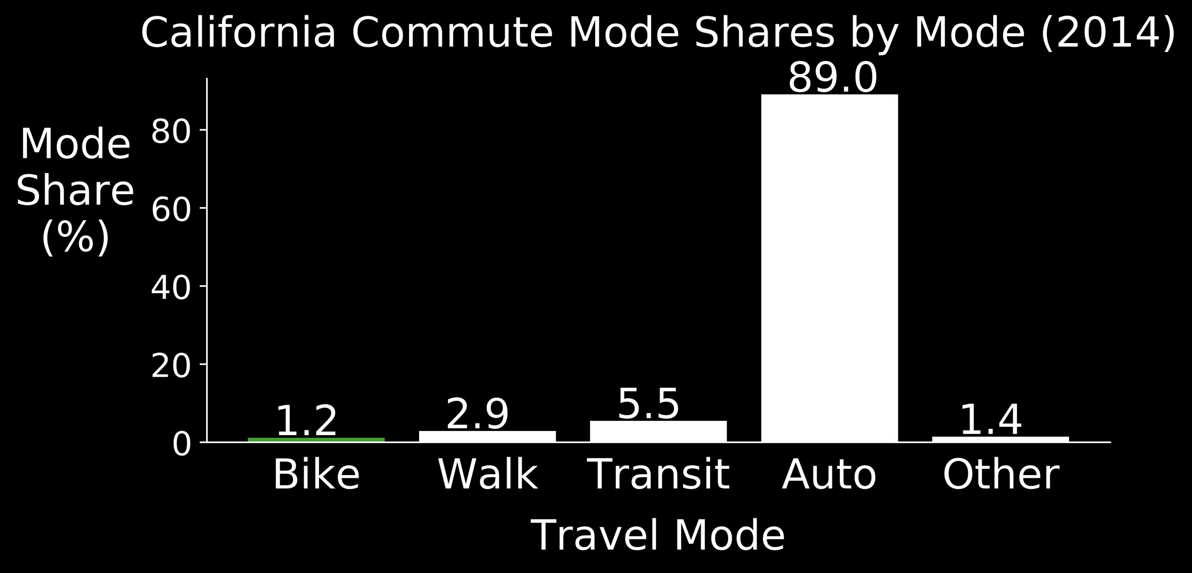
Cyclists are a minority

Slide 37
No cyclists, No Problem?
Wrong. Low (relative) numbers of cyclists cause:
Finite sample bias in parameter estimates
“Logistic Regression in Rare Events Data”, King and Zeng (2001)
Finite sample bias in predicted probabilities
“Logistic Regression in Rare Events Data”, King and Zeng (2001)
Decreased predictive performance
“Predictive performance of the binary logit model in unbalanced samples”, Cramer (1999)

Slide 38
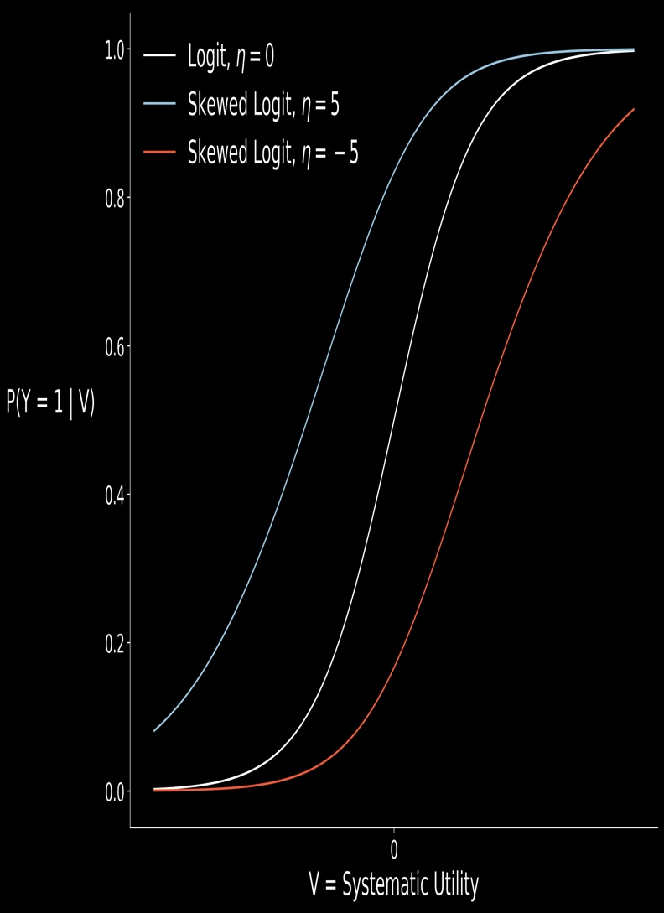
How have minority alternatives been modeled in other disciplines?
Chen et al. (1999), “A New Skewed Link Model for Dichotomous Quantal Response Data”

Slide 39

Why no Asymmetry in Transportation?
Ad-Hoc Creation Procedures

Slide 40
Two Alternatives
Many Alternatives

Slide 41
Summary of Contributions (Part 3)
Developed algorithms to:
create binary, asymmetric choice models
extend binary asymmetric models to multinomial setting
Created 4 new asymmetric models as examples

Slide 42
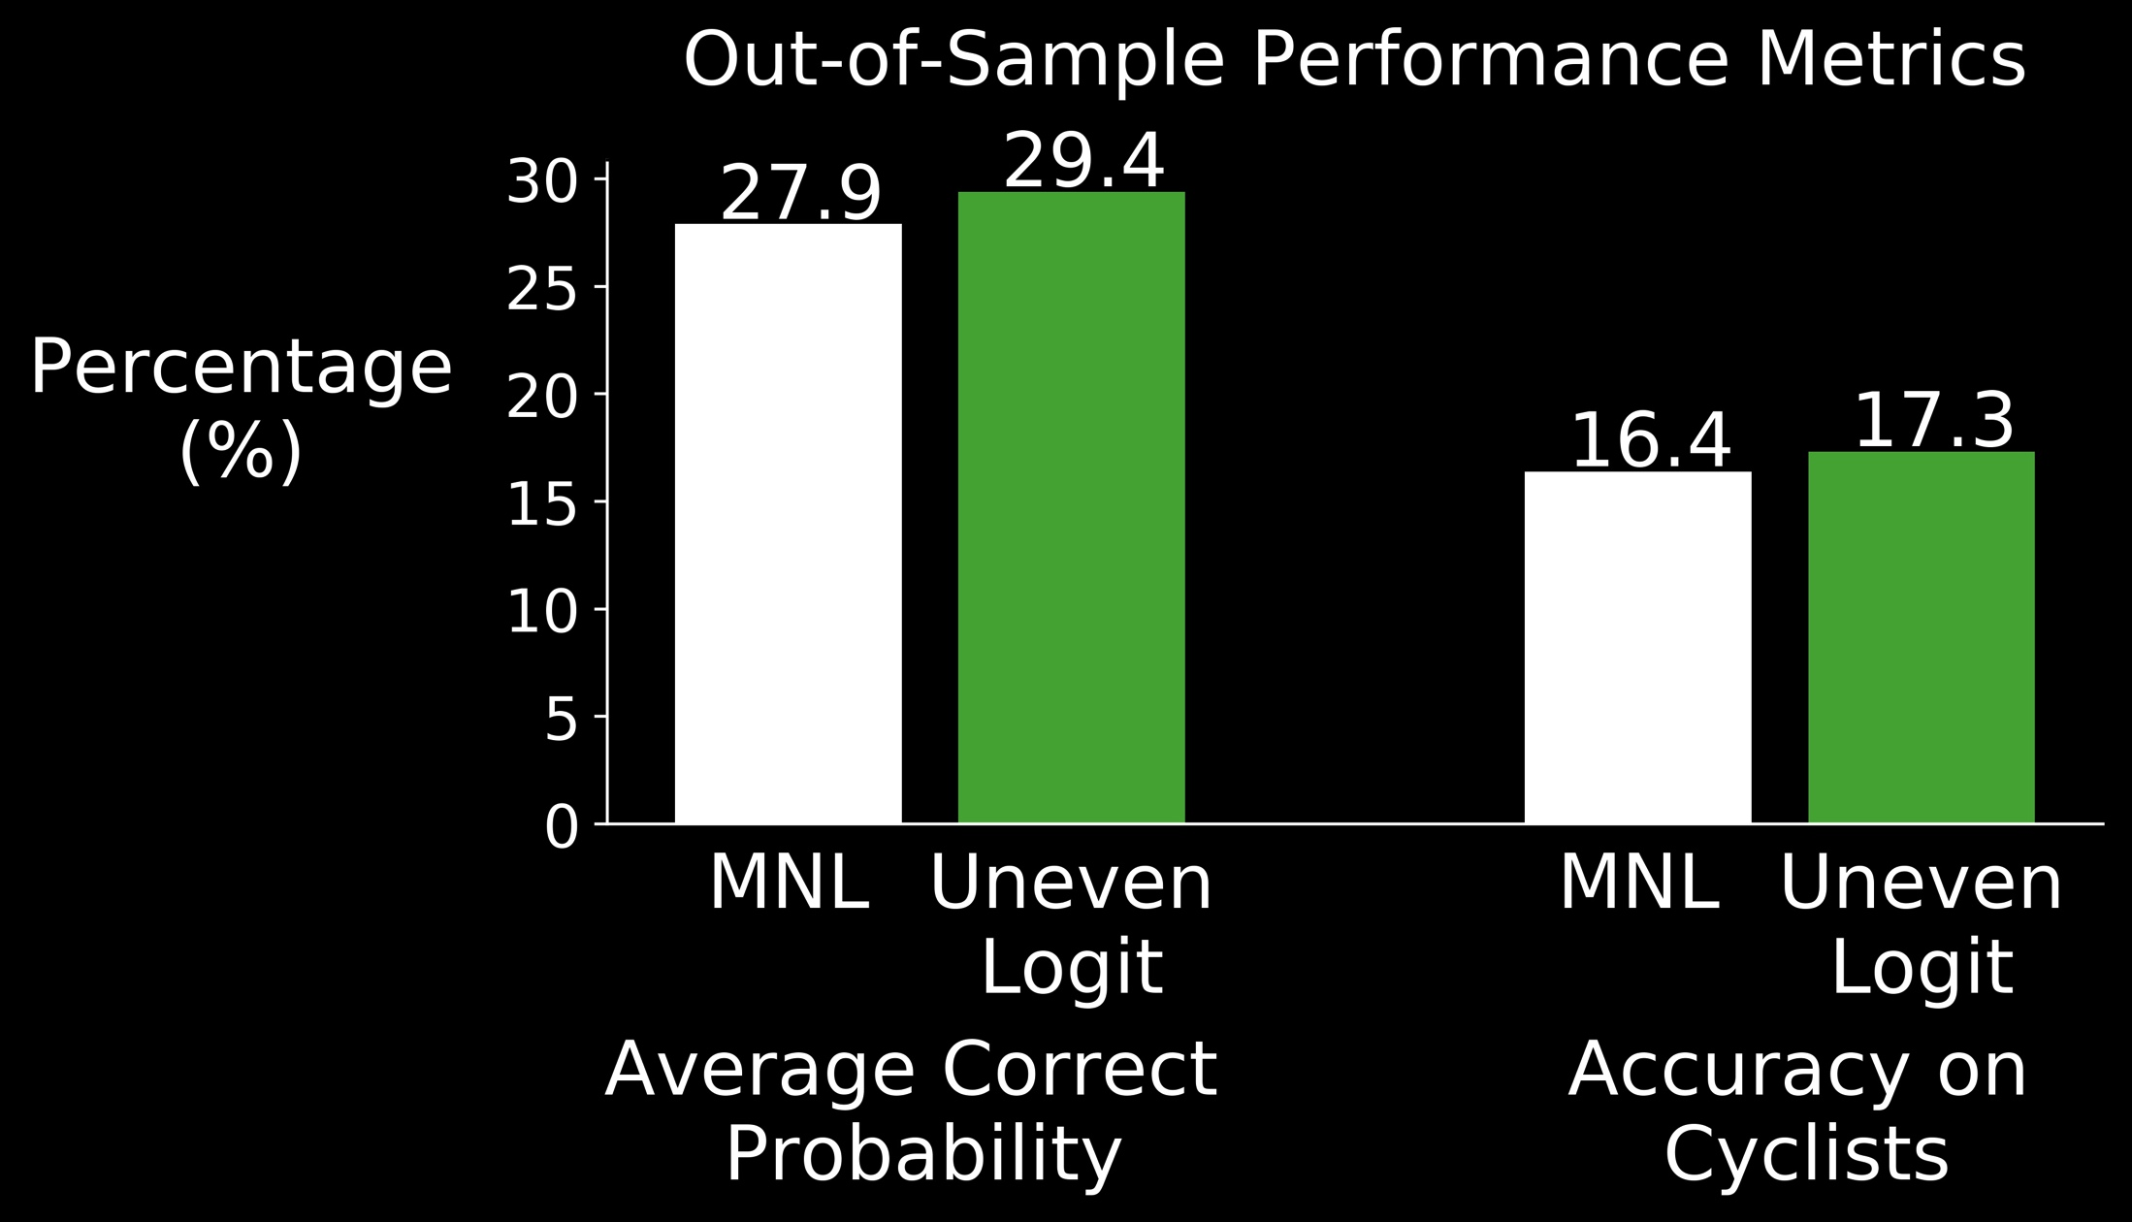
What have we gained?
Greater Model Accuracy

Slide 43
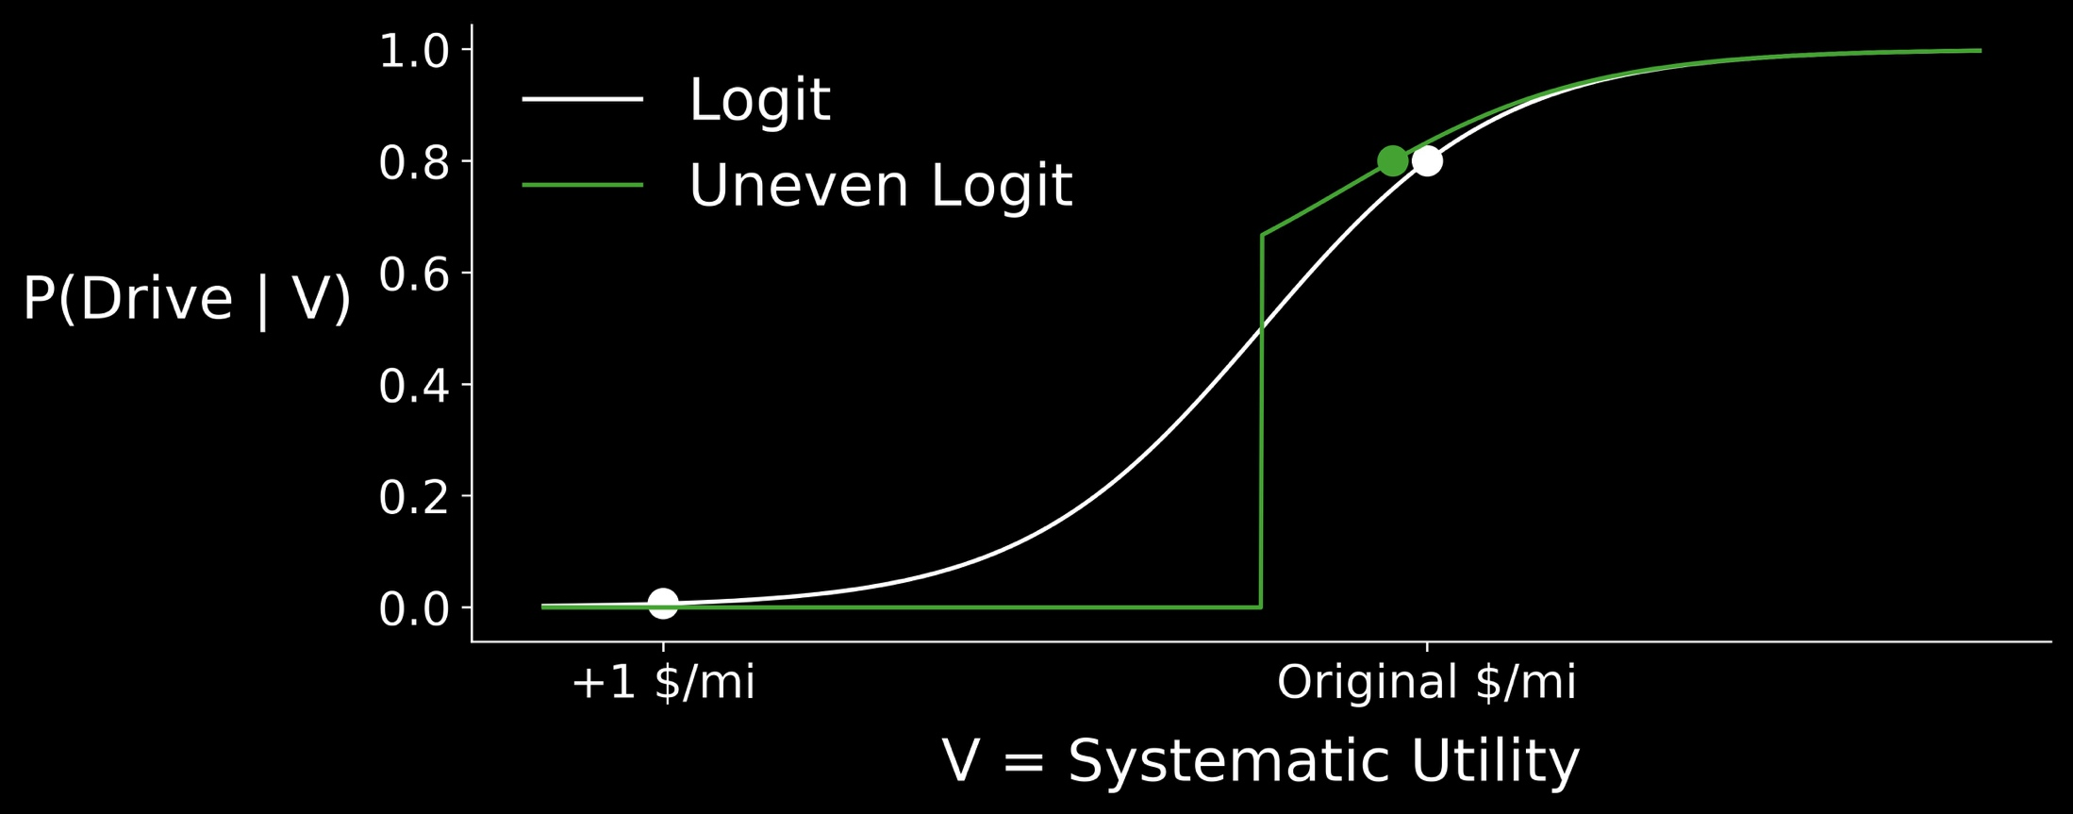
What have we gained?
Behavioral Insights: From Adoption to Abandonment

Slide 44
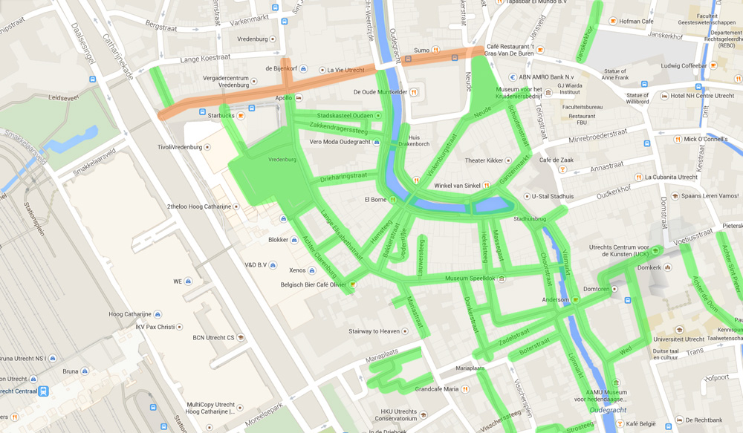
What have we gained?
Stick Assessment: From Adoption to Abandonment

Slide 45
Takeaways from the dissertation:
Thoughtfully incorporate roadway-level variables
Model the reality of ‘irrational’ travelers
Allow for asymmetric abandonment and adoption as an explanation for low cycling numbers

Slide 46
Are we good to go?

Slide 47
Are we good to go?
Not Yet

Slide 48
What else?
“No Causation Without Manipulation”

Slide 49
What else?
Optimize, optimize, optimize… proactively.

Slide 50
What else?
Comprehensive Analysis of Heterogeneity
Notes:
Different approaches to incorporating heterogeneity in choice sets and preferences. Comparison with previous work.

Slide 51
Thanks for Listening!
Timothy Brathwaite

Slide 52
Acknowledgements

Slide 53
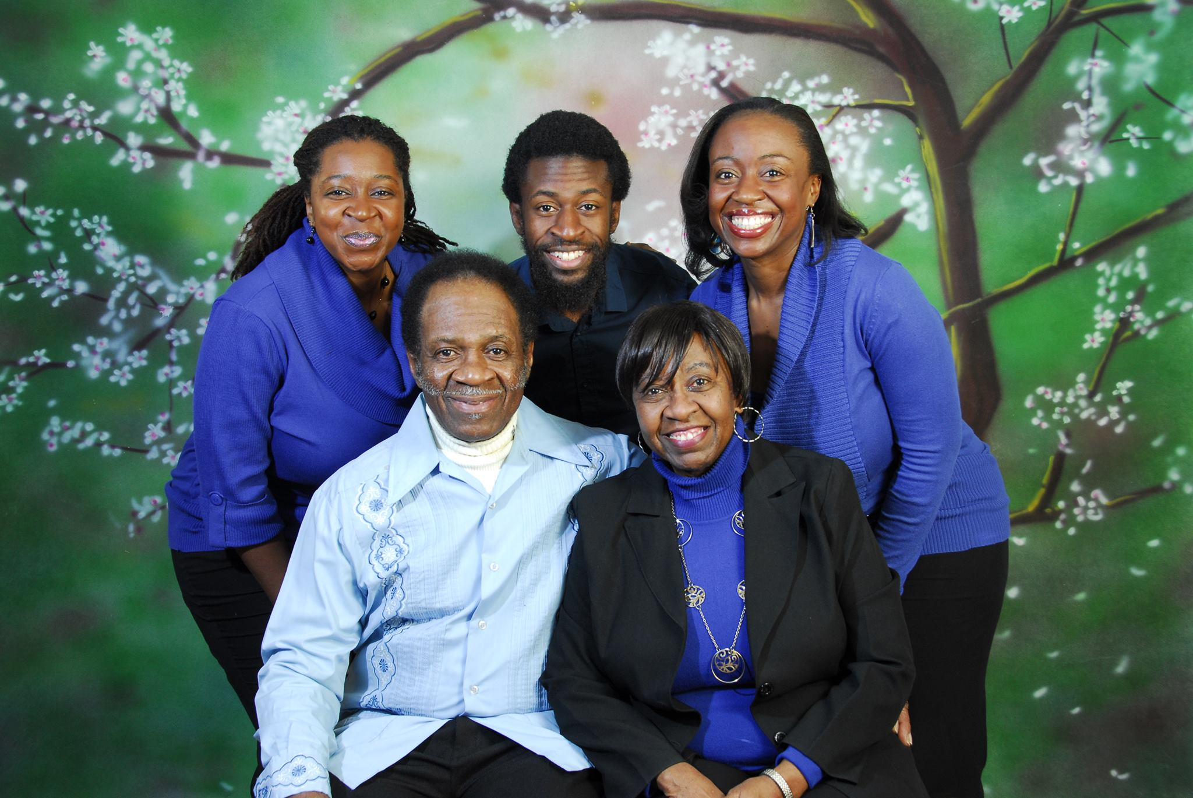

Slide 54
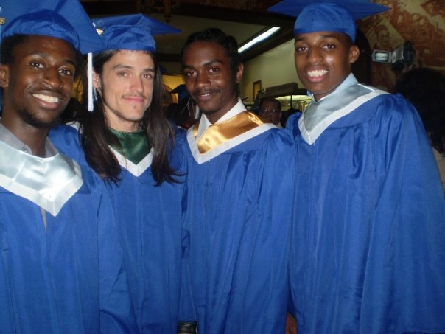

Slide 55
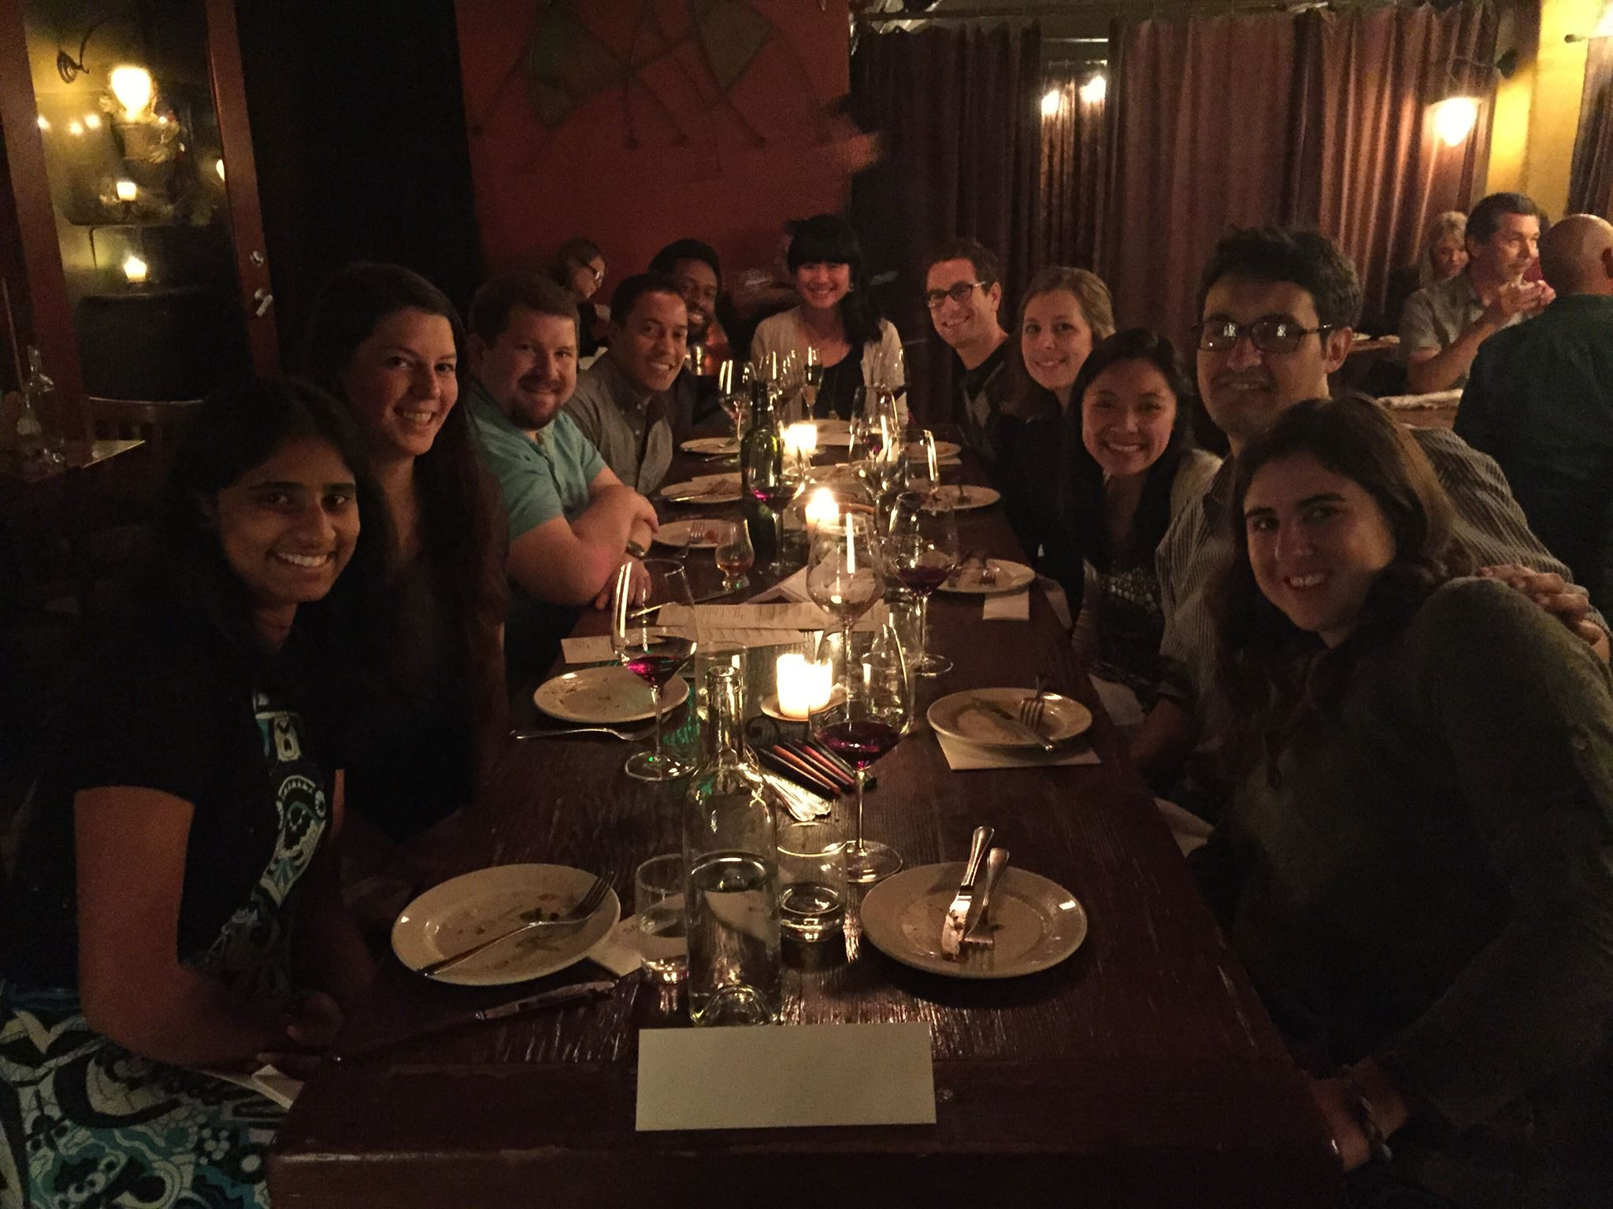
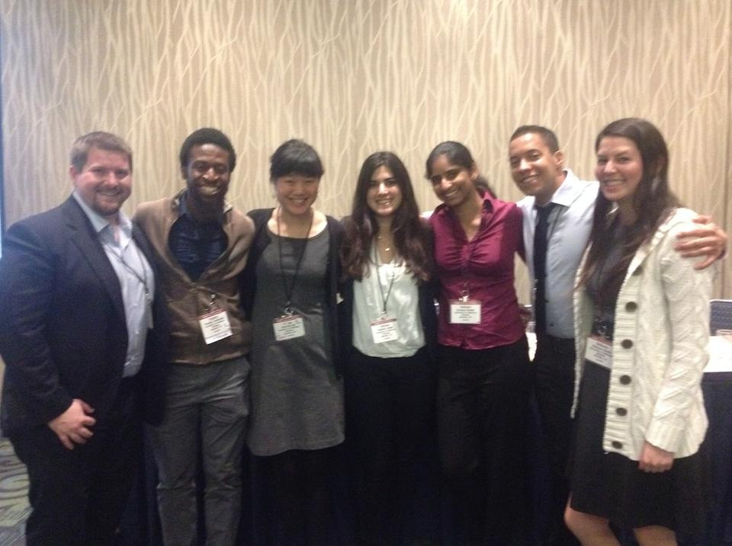

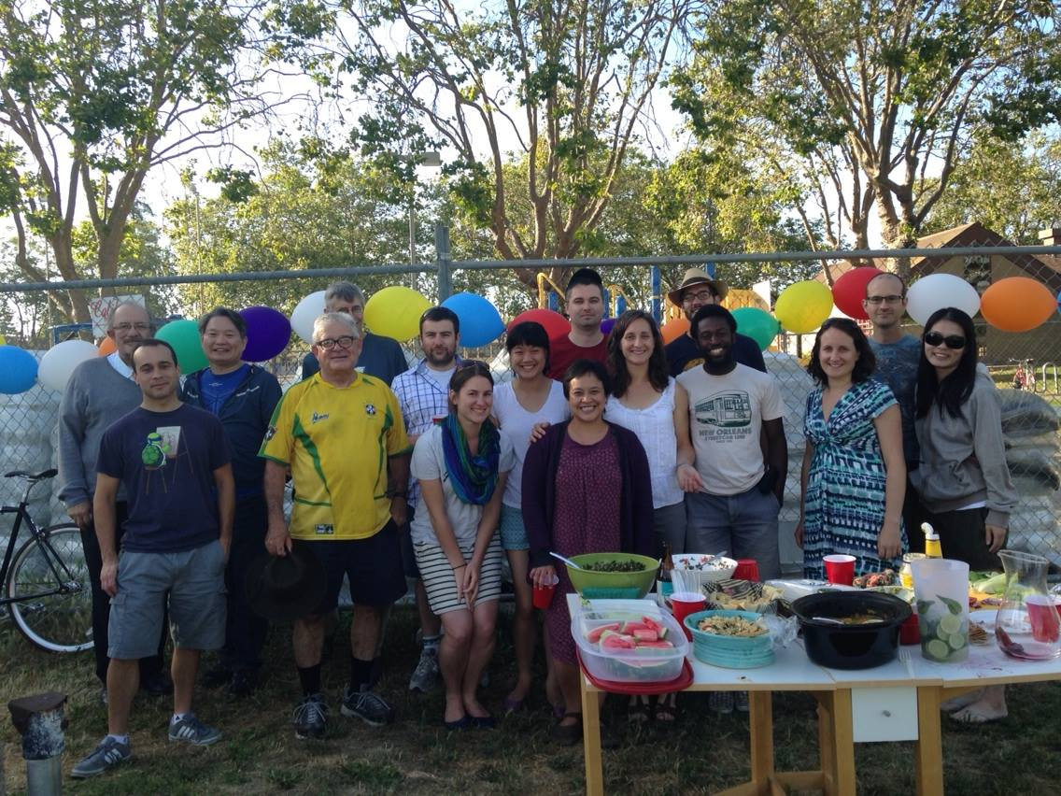

Slide 56
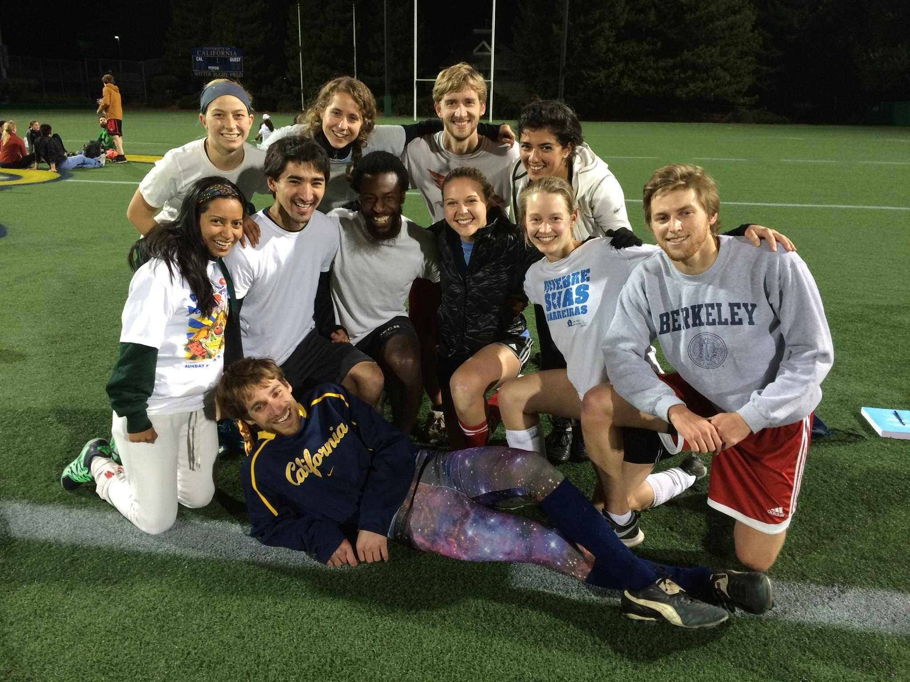
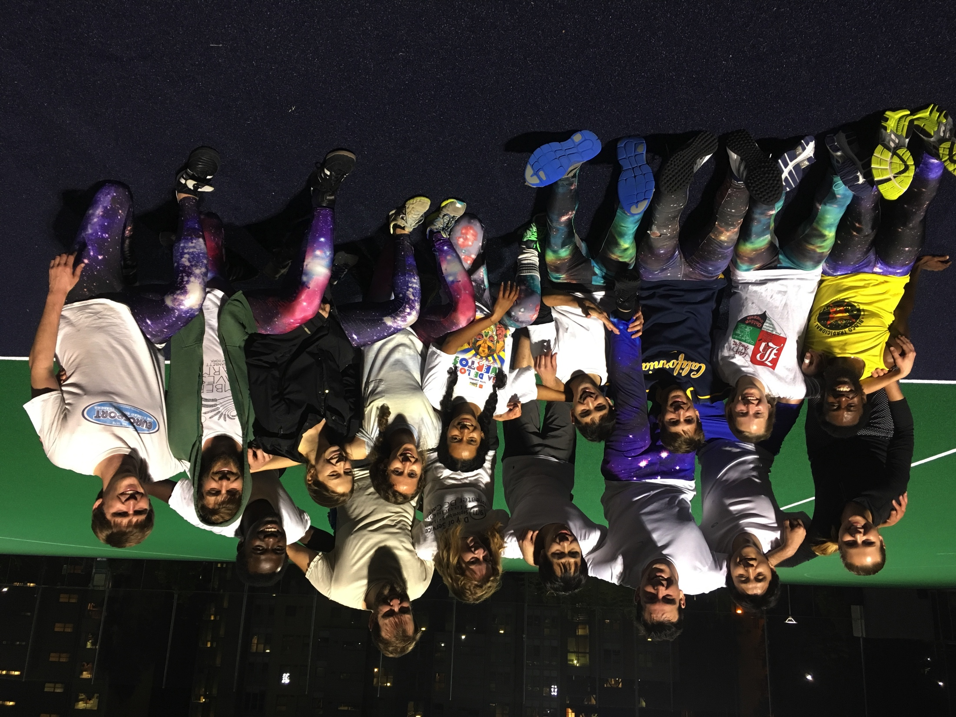
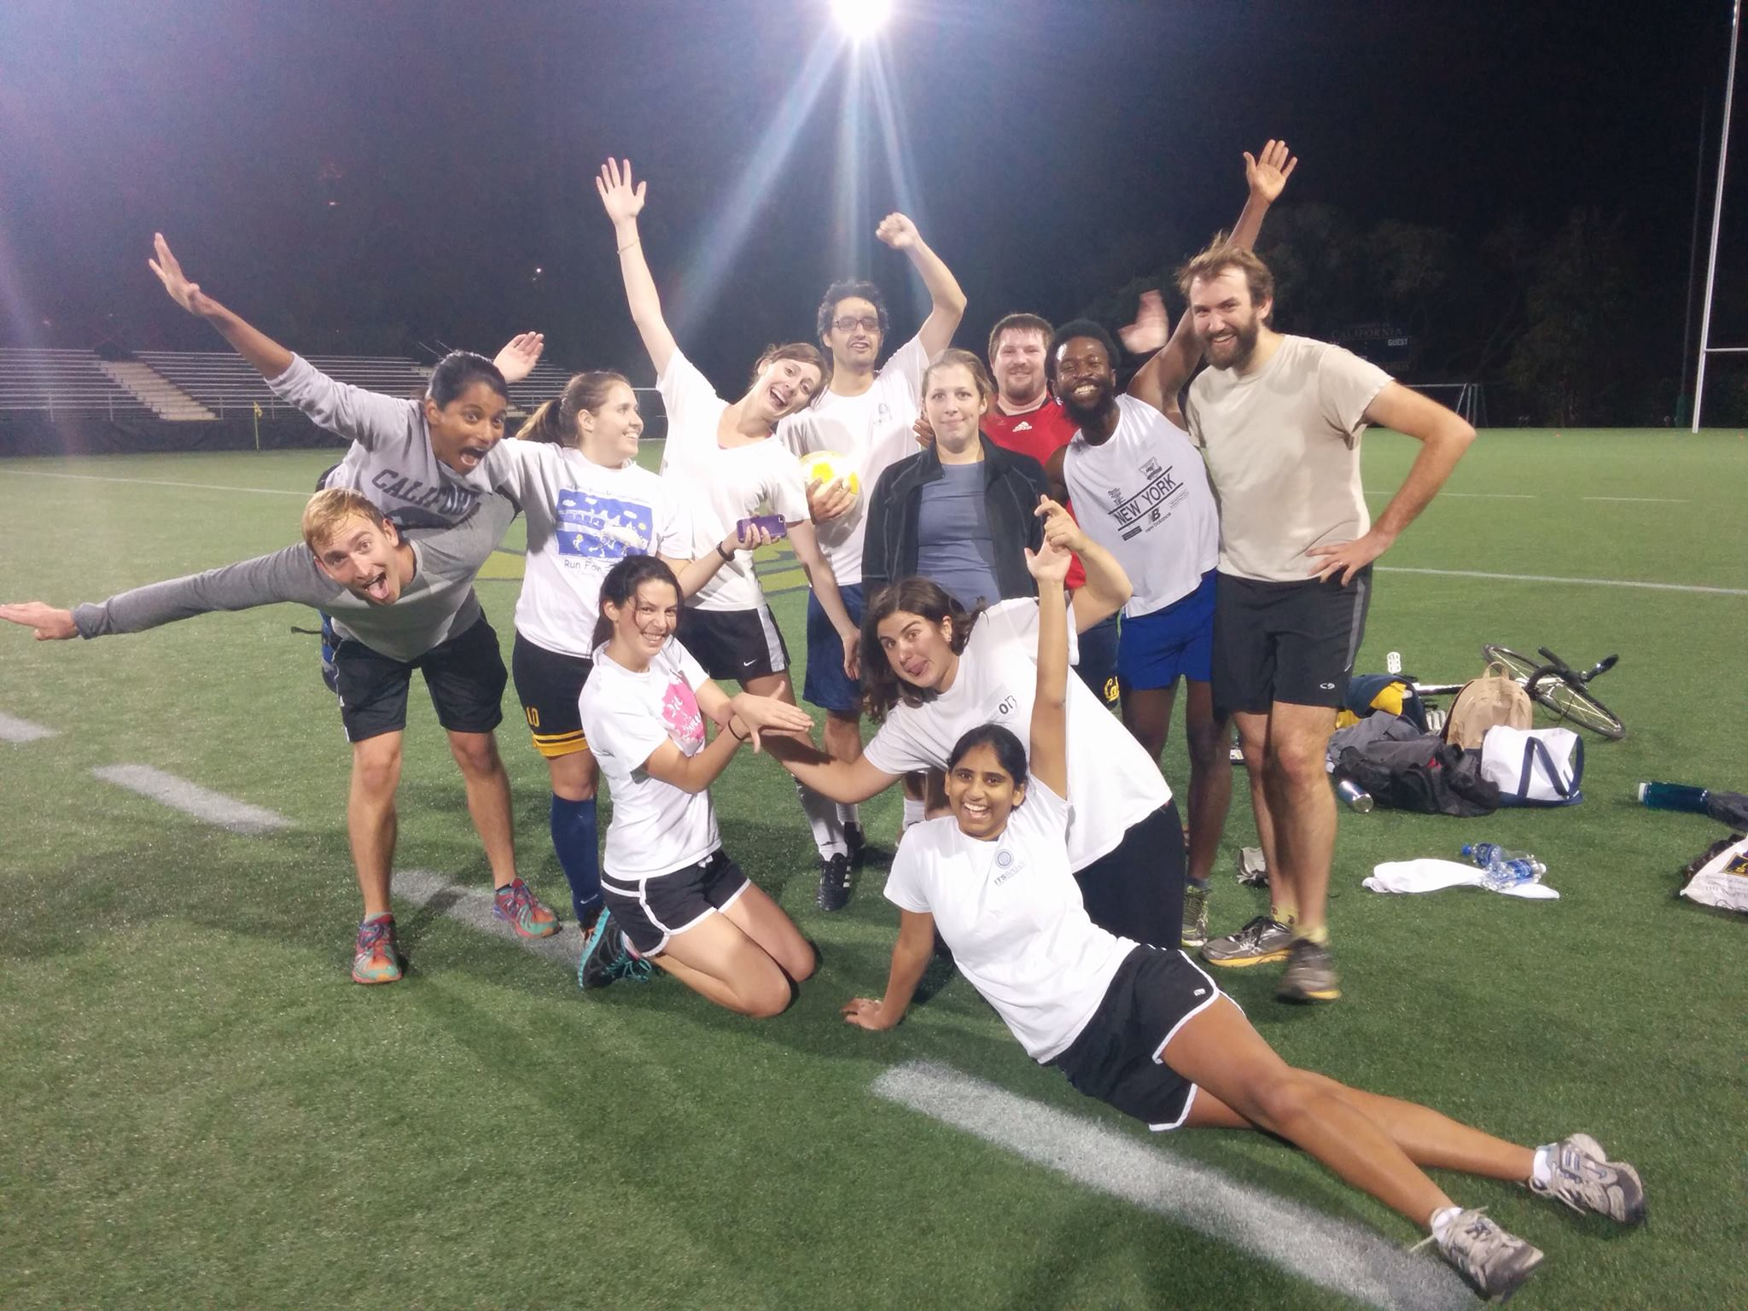
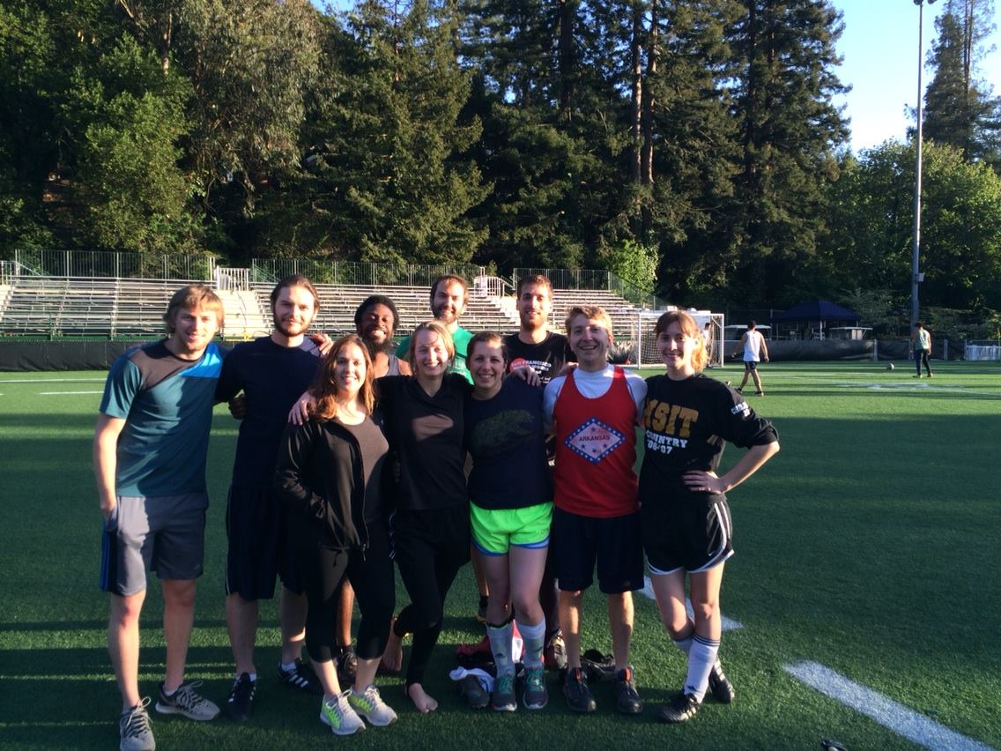

Slide 57
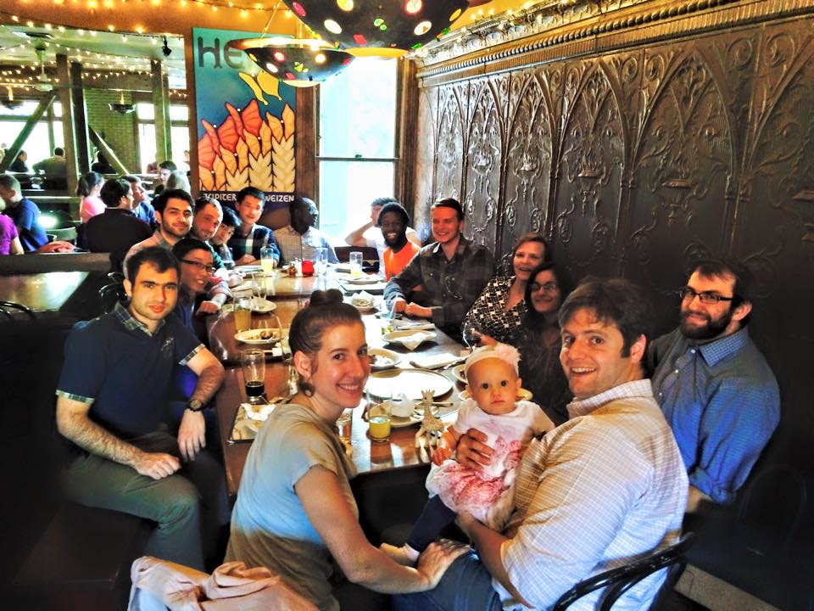
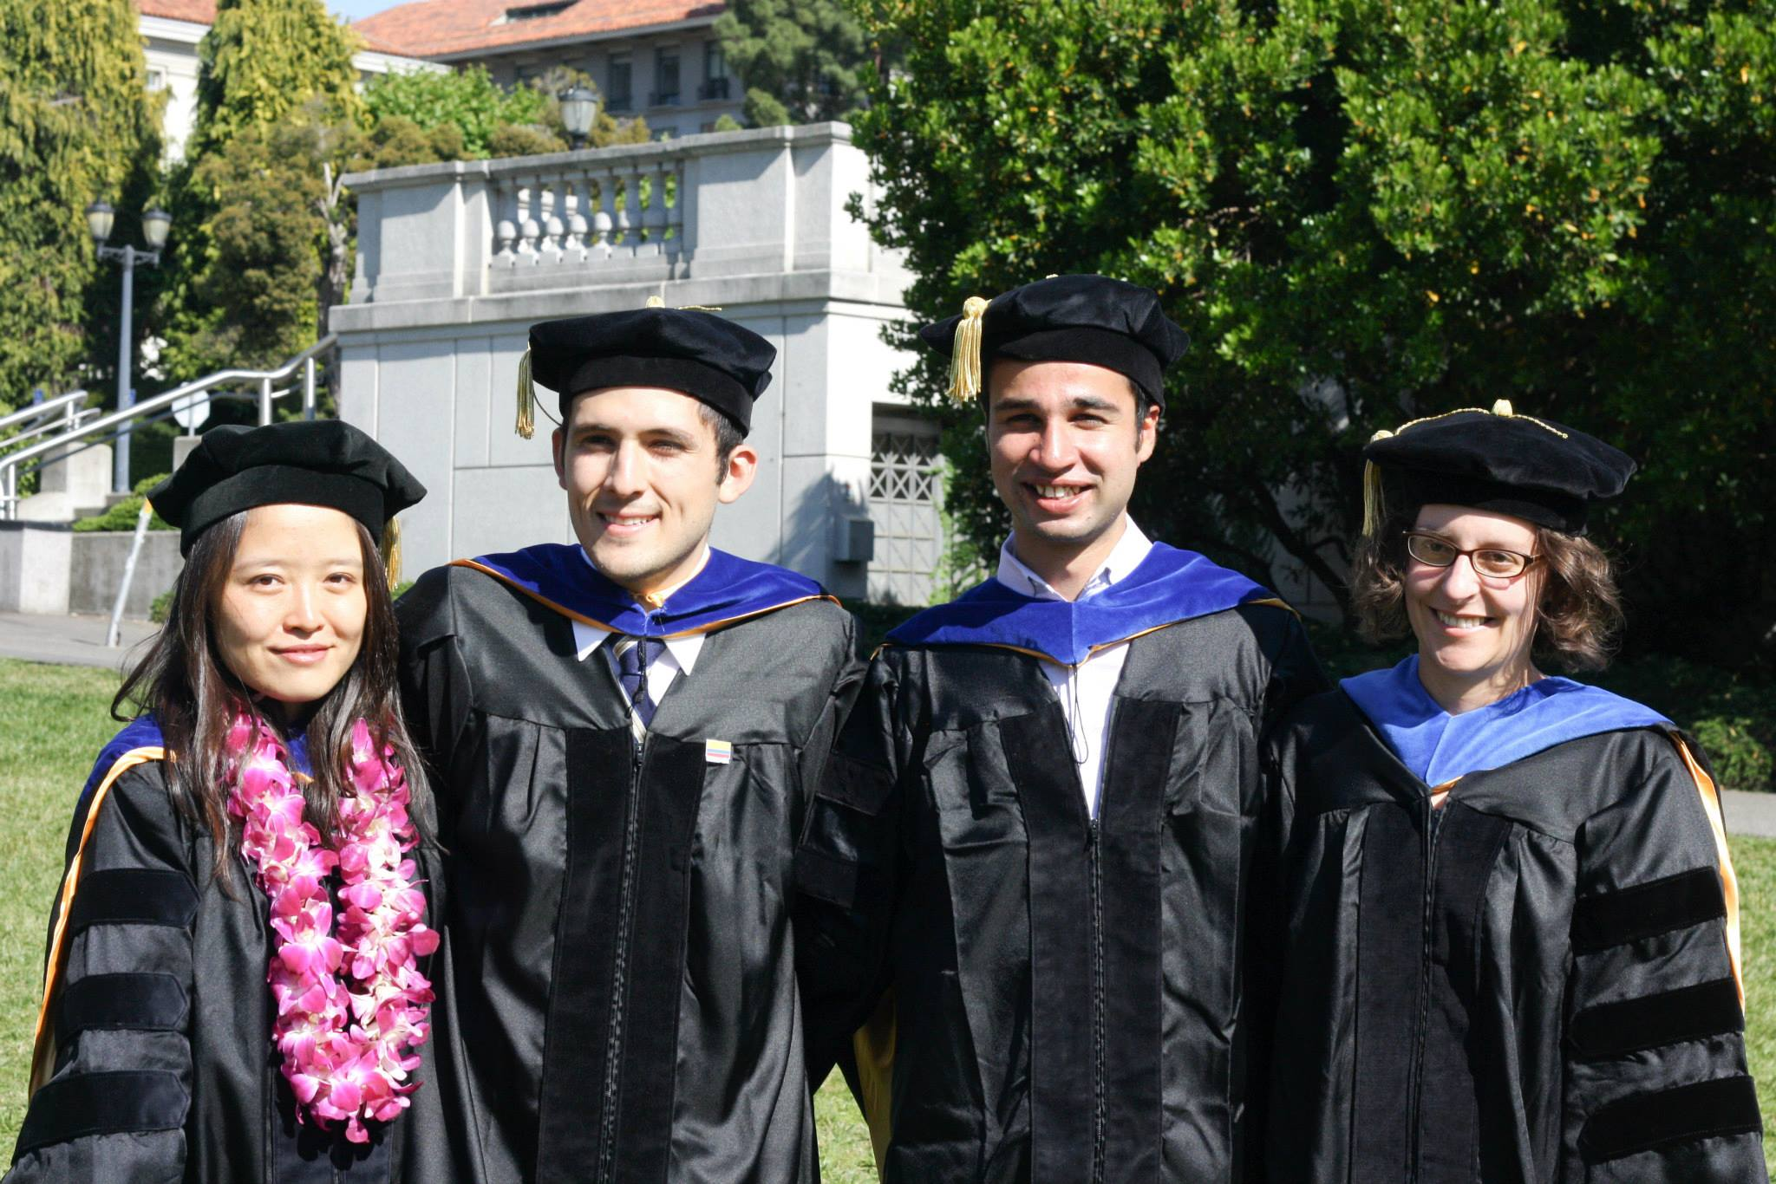
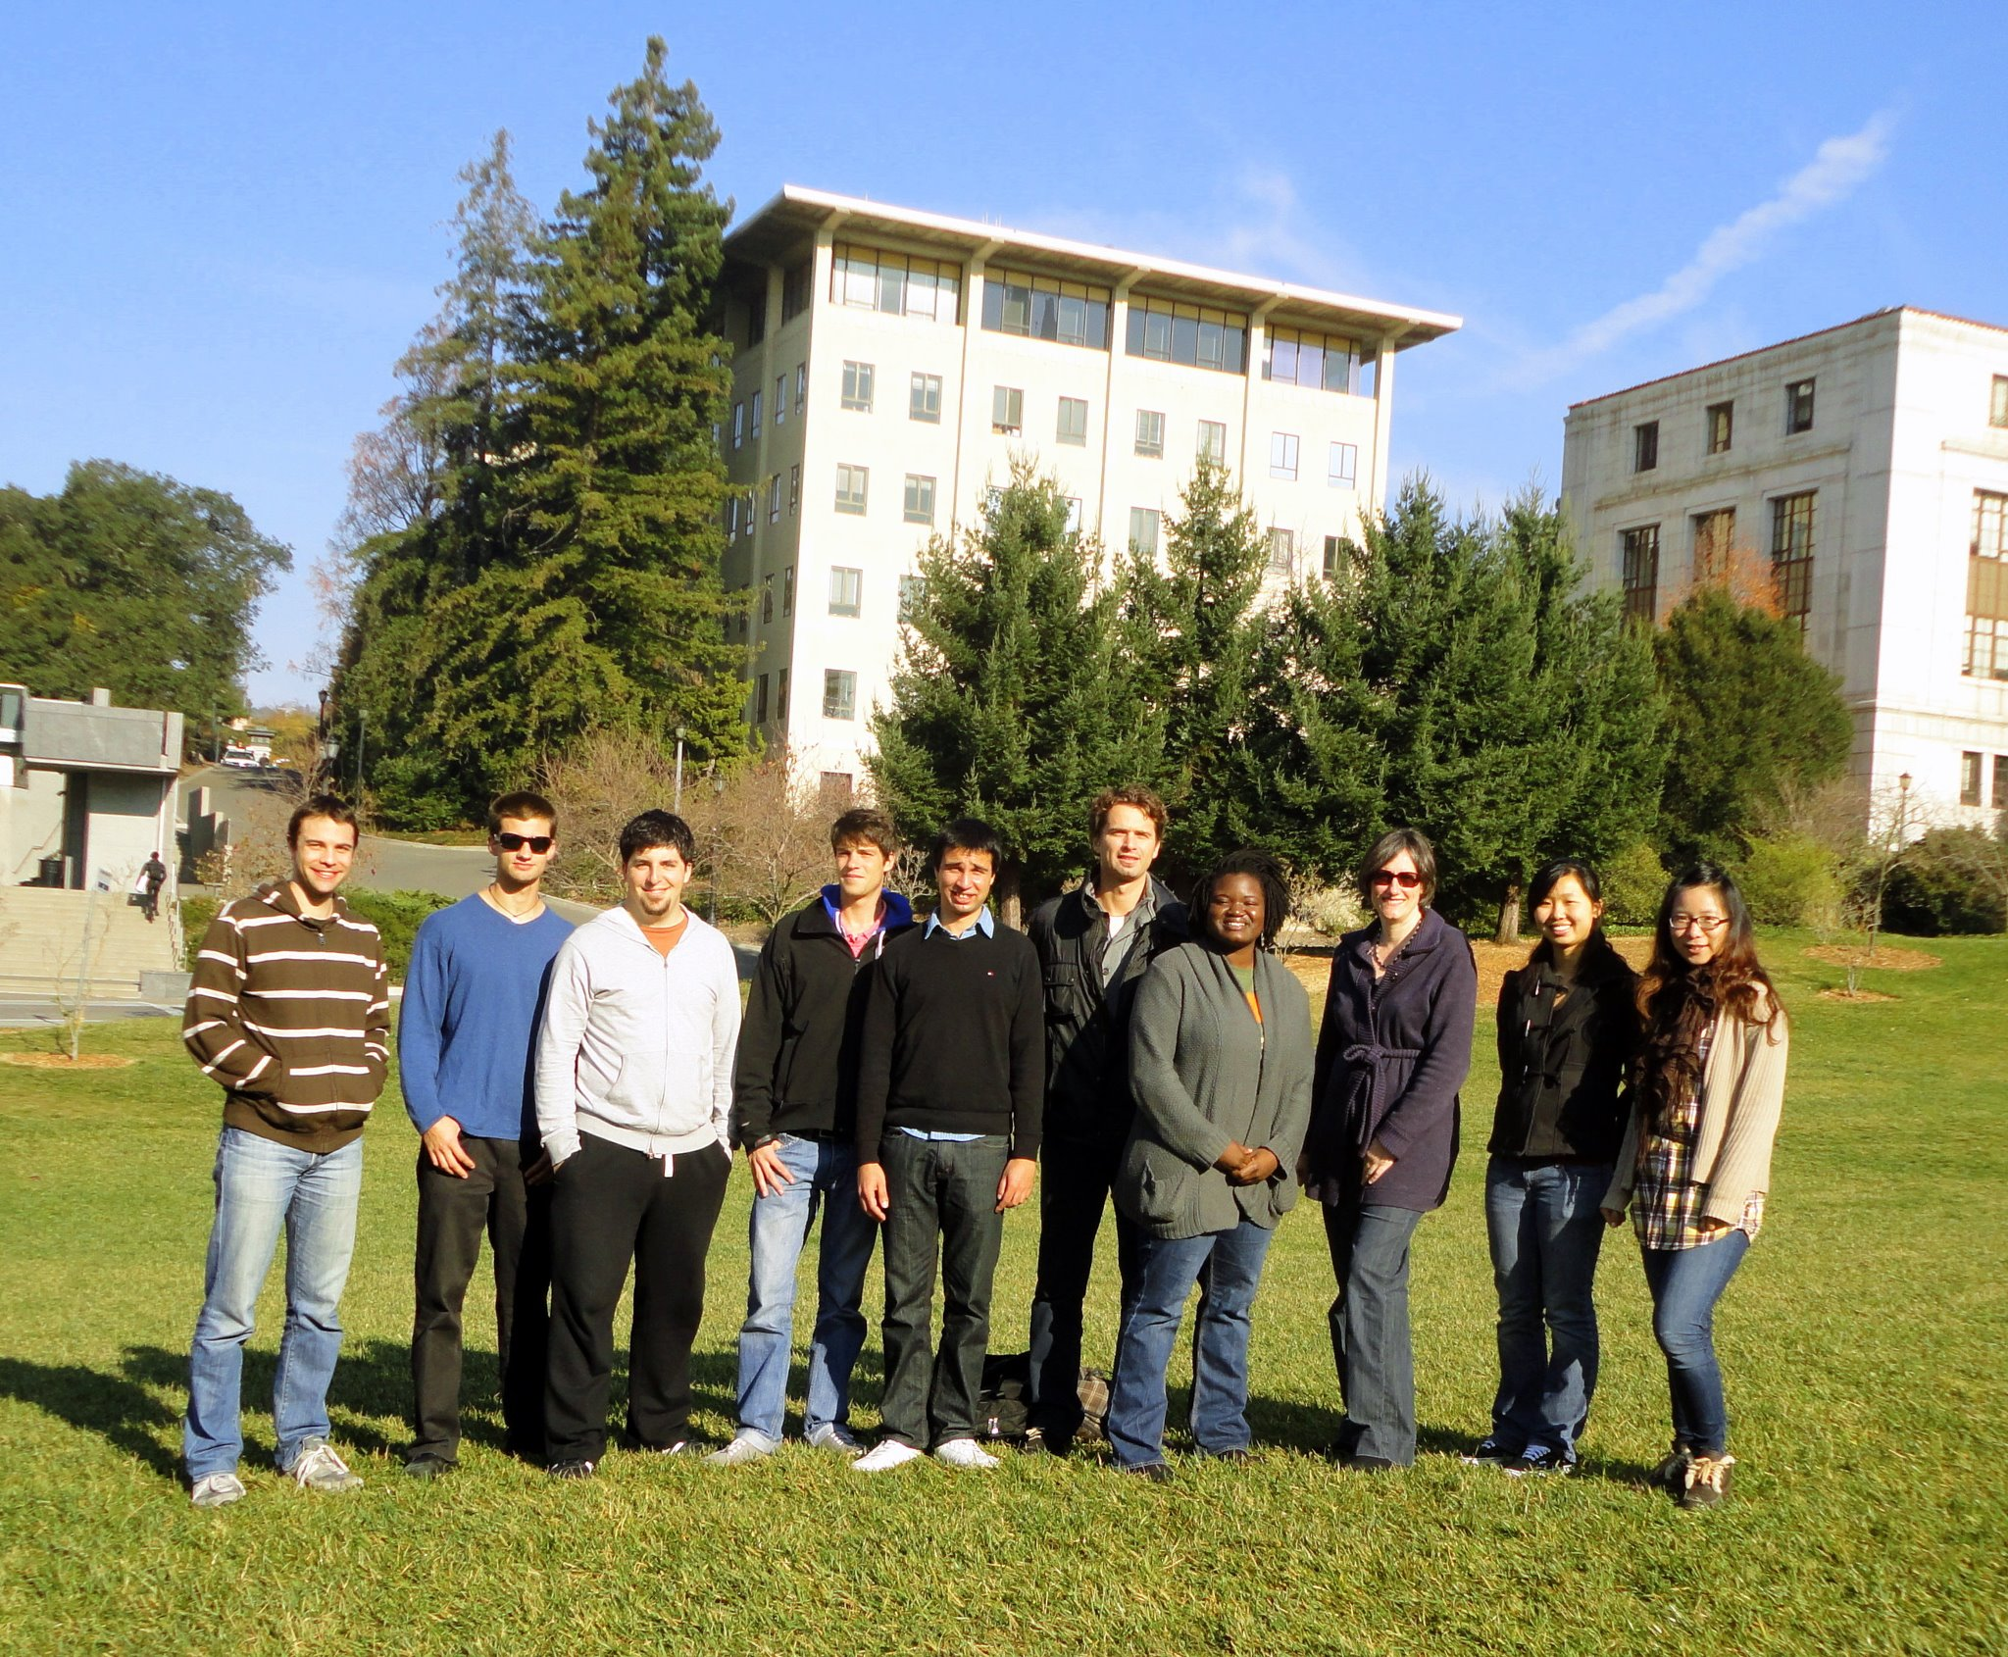
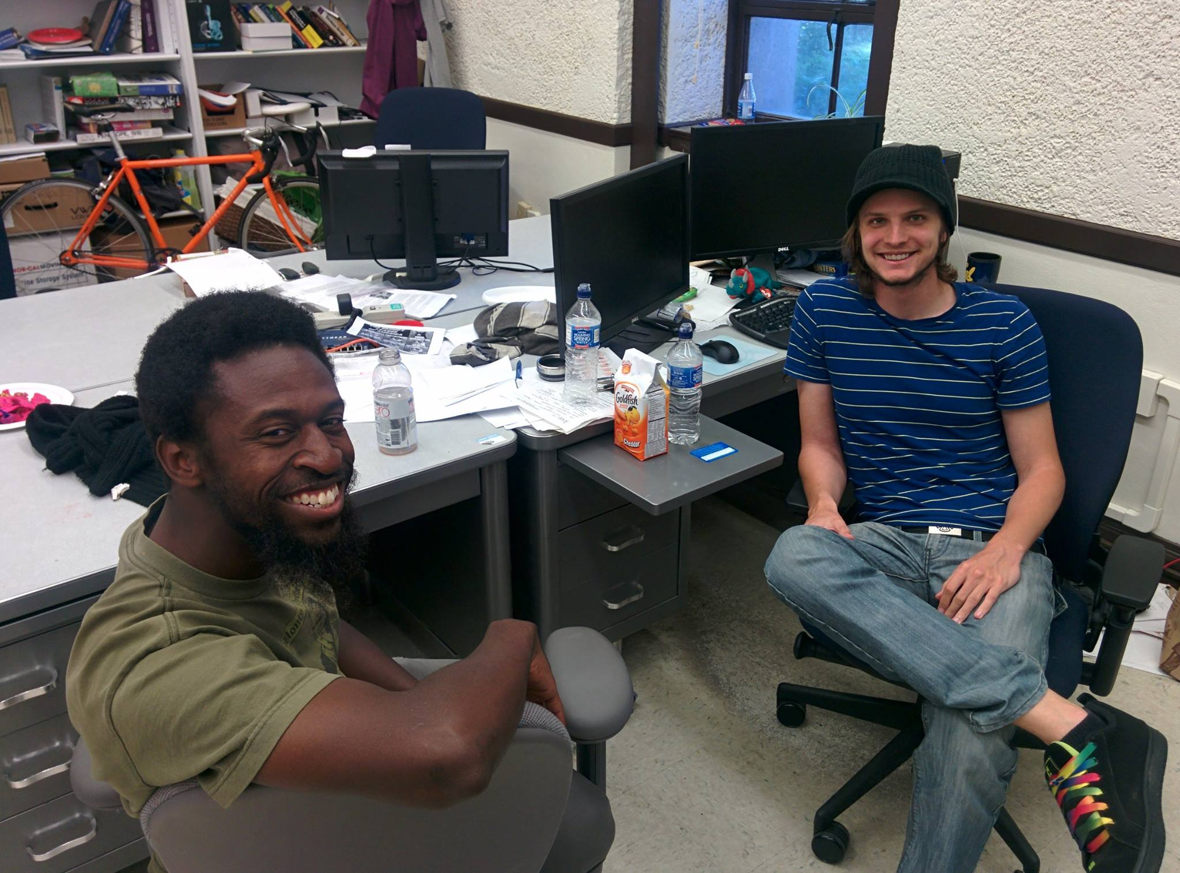

Slide 58
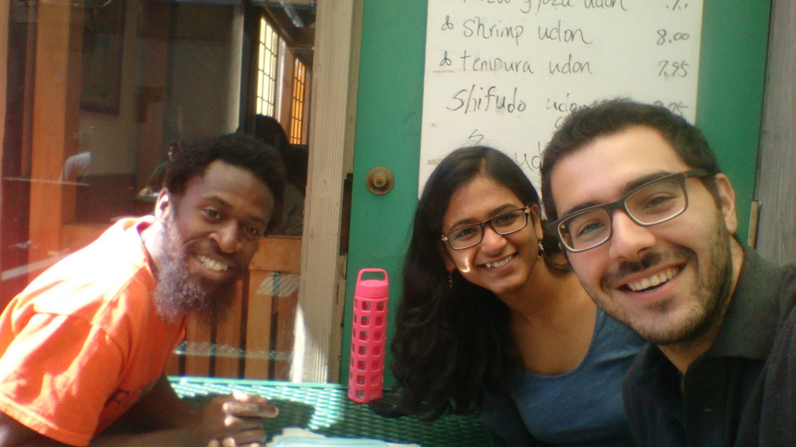


Slide 59


Slide 60


Slide 61
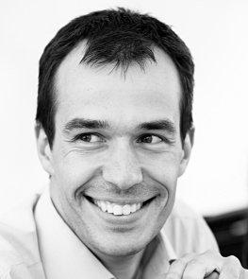
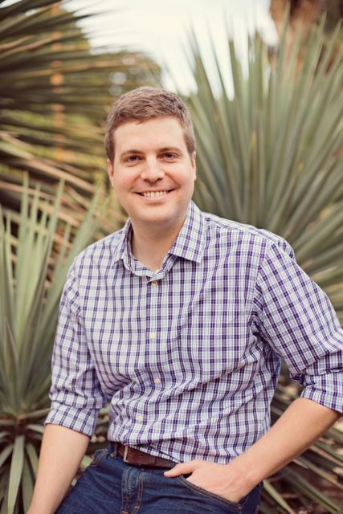

Slide 62
